Slide 1
Neural networks in Computer Vision: CNN
some materials created by Brandon Rohrer

Slide 2
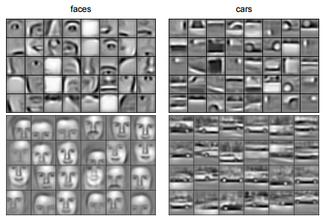
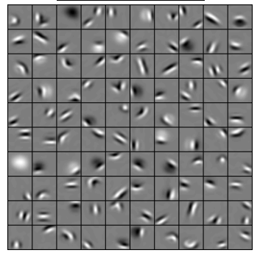
Convolutional Deep Belief Networks for Scalable Unsupervised Learning of Hierarchical Representations Honglak Lee, Roger Grosse, Rajesh Ranganath, Andrew Y. Ng

Slide 3
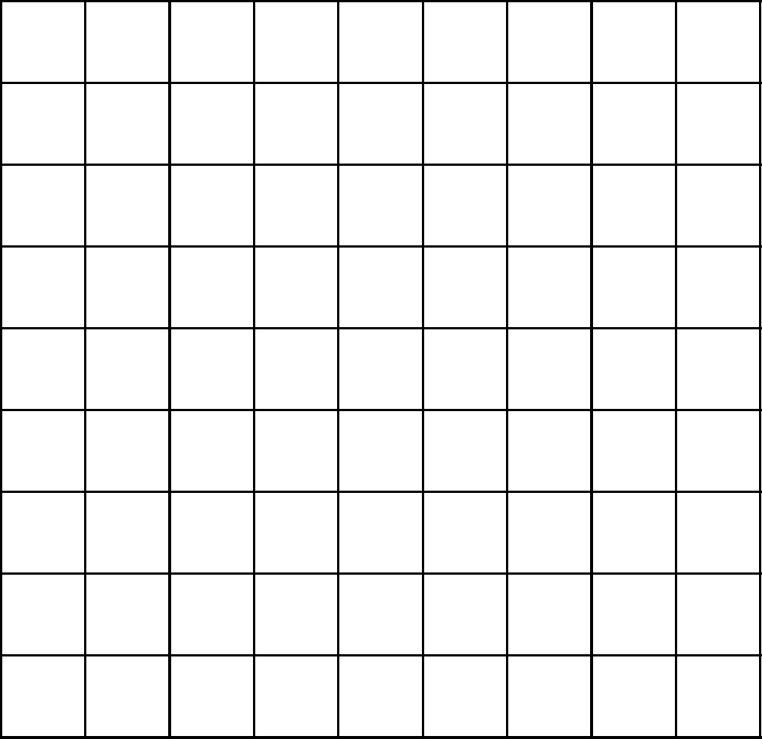
A toy ConvNet: X’s and O’s
Says whether a picture is of an X or an O
A two-dimensional
array of pixels
CNN
X or O

Slide 4
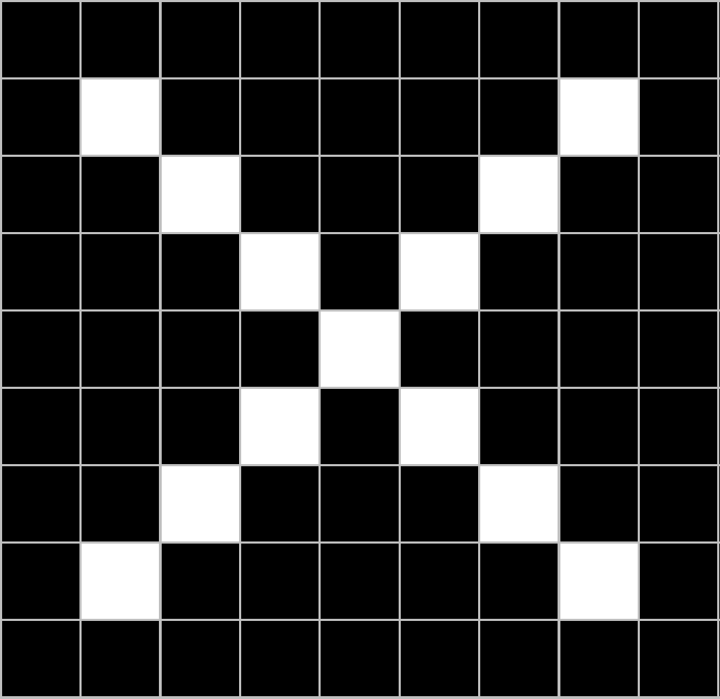
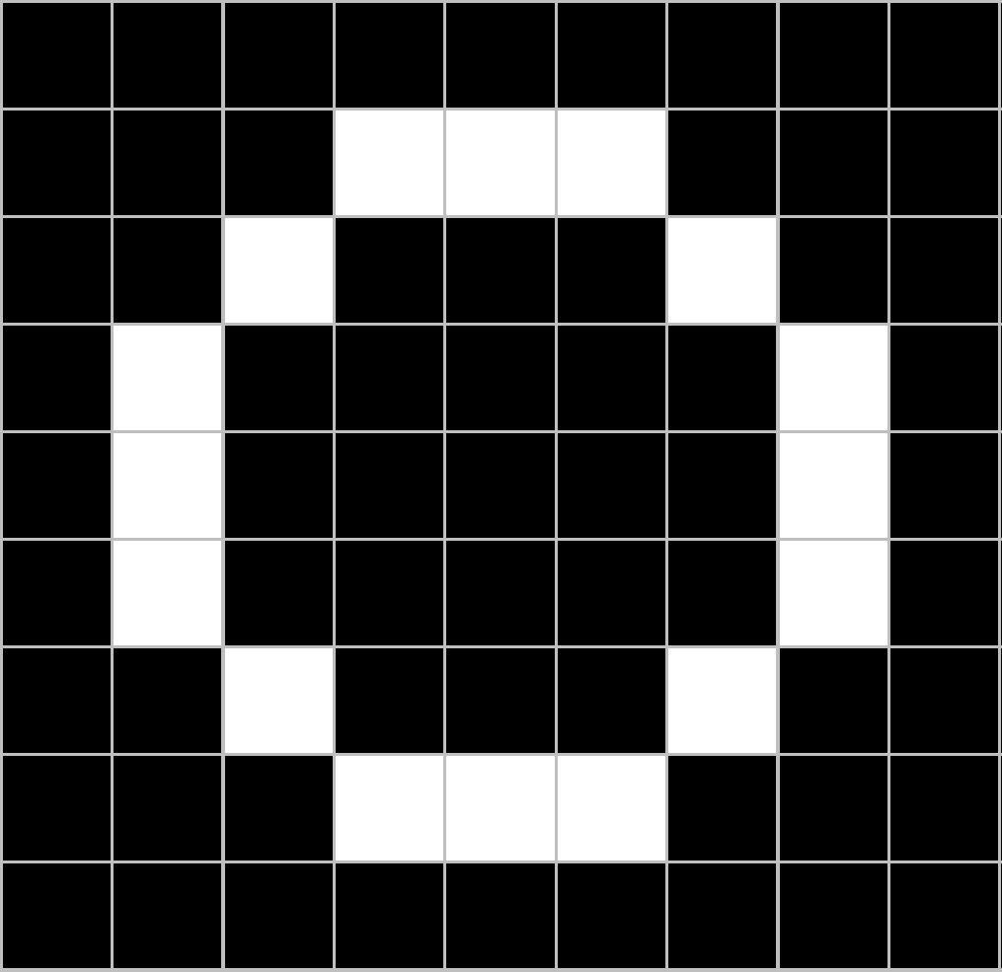
For example
CNN
X
CNN
O

Slide 5
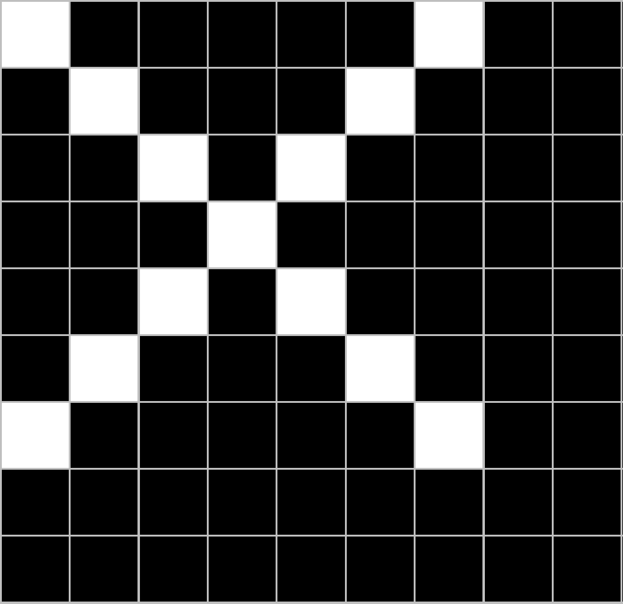
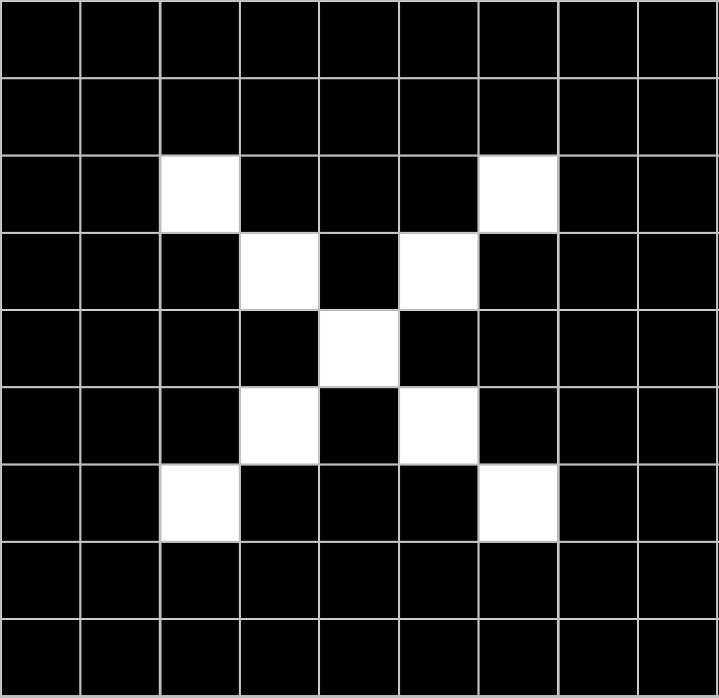
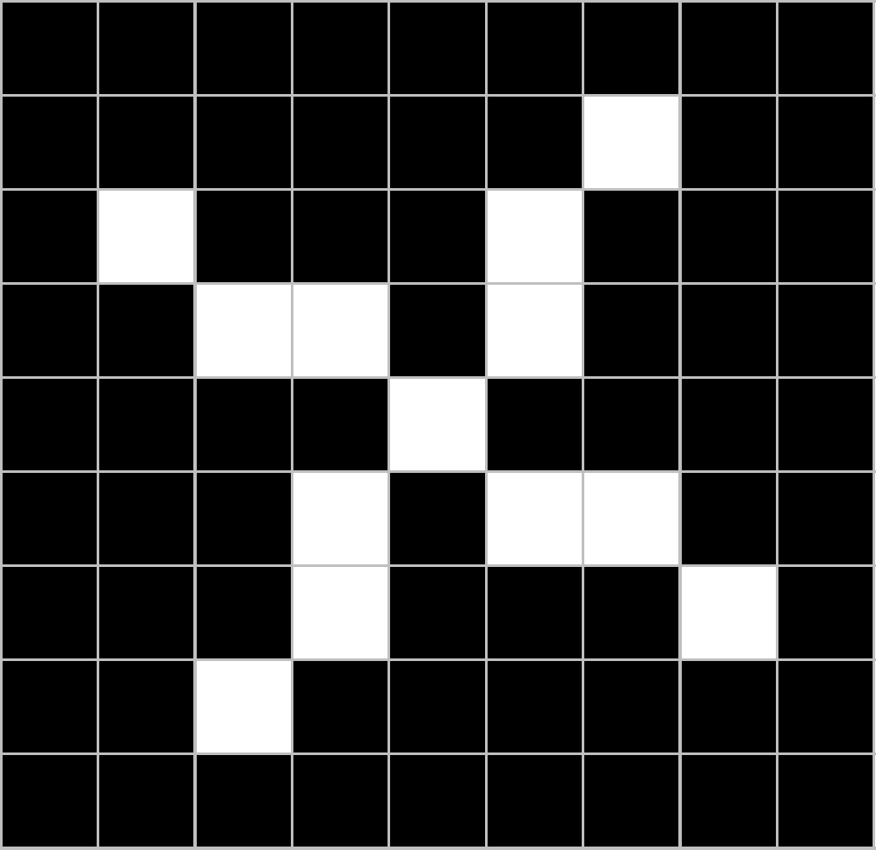
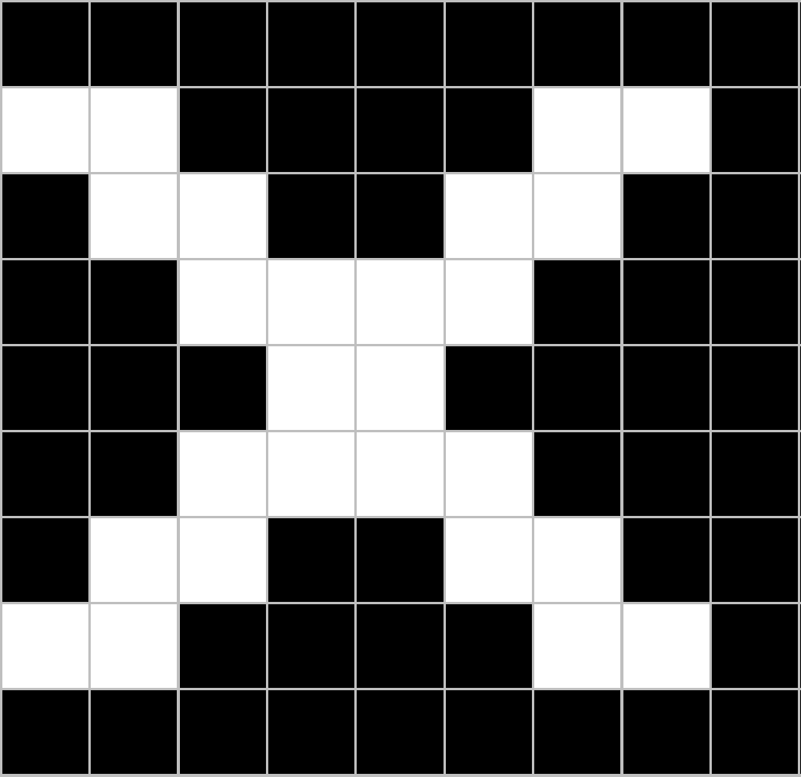
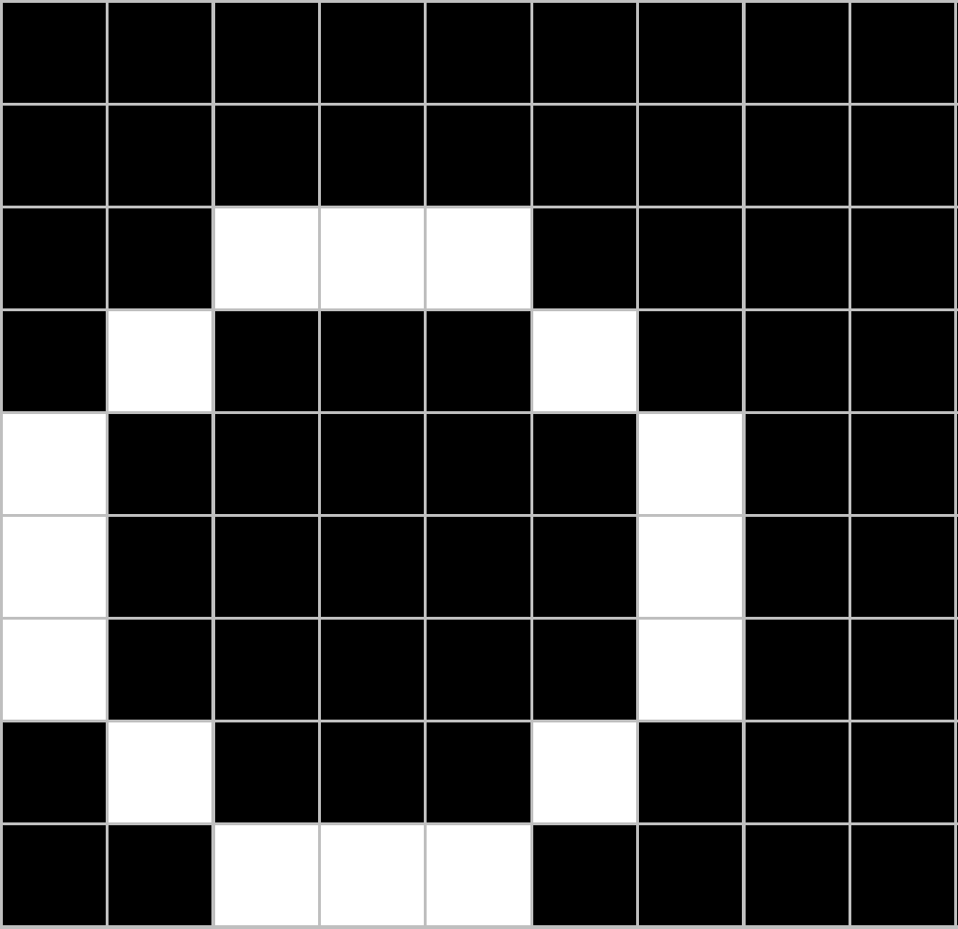
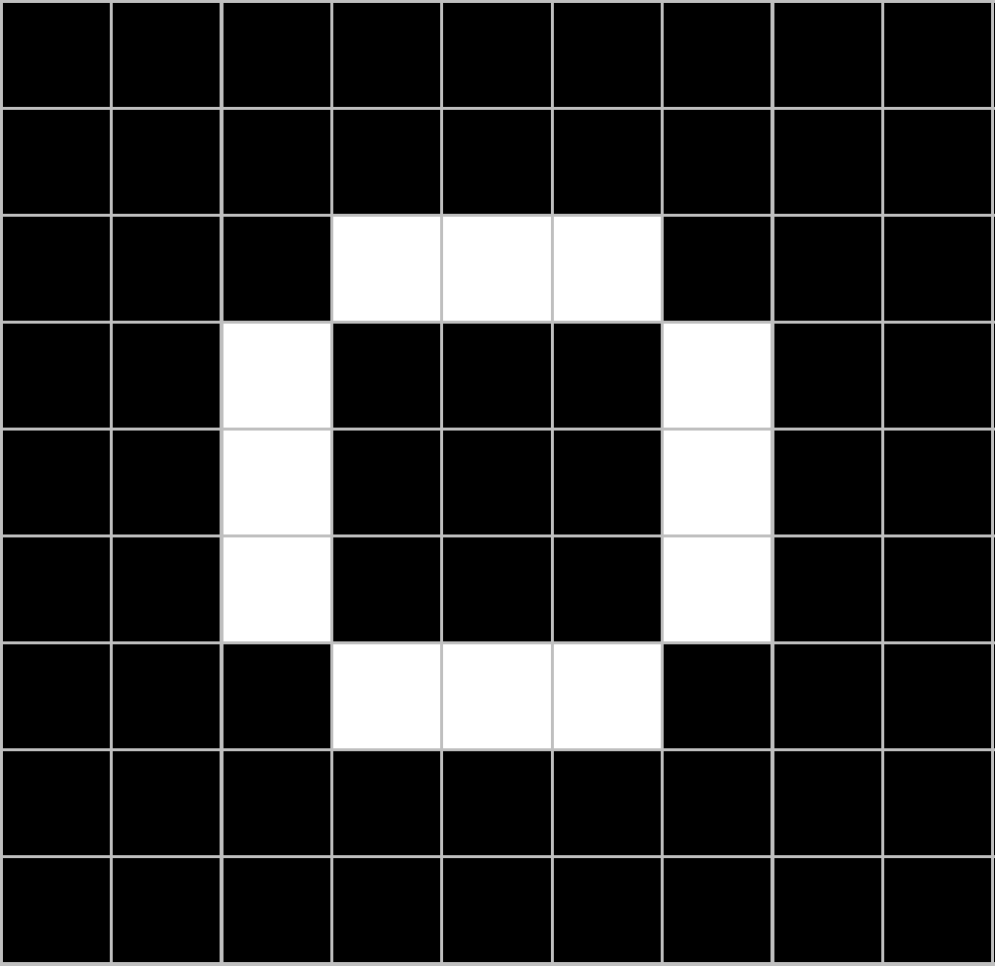
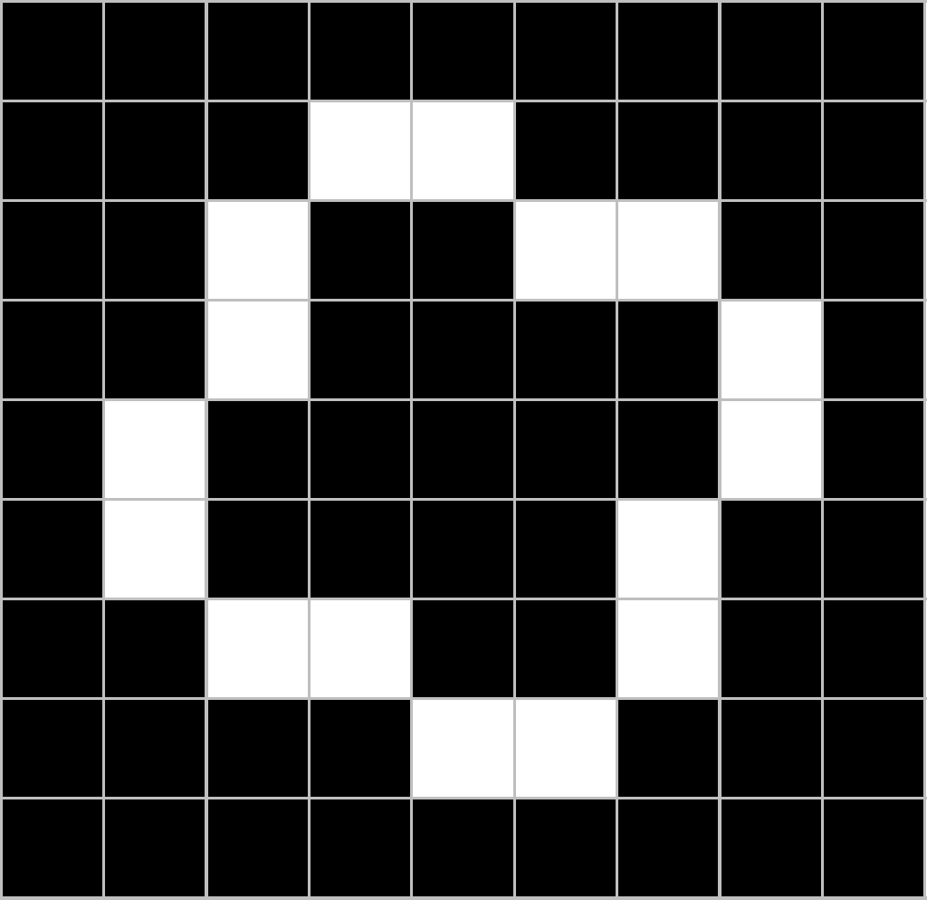
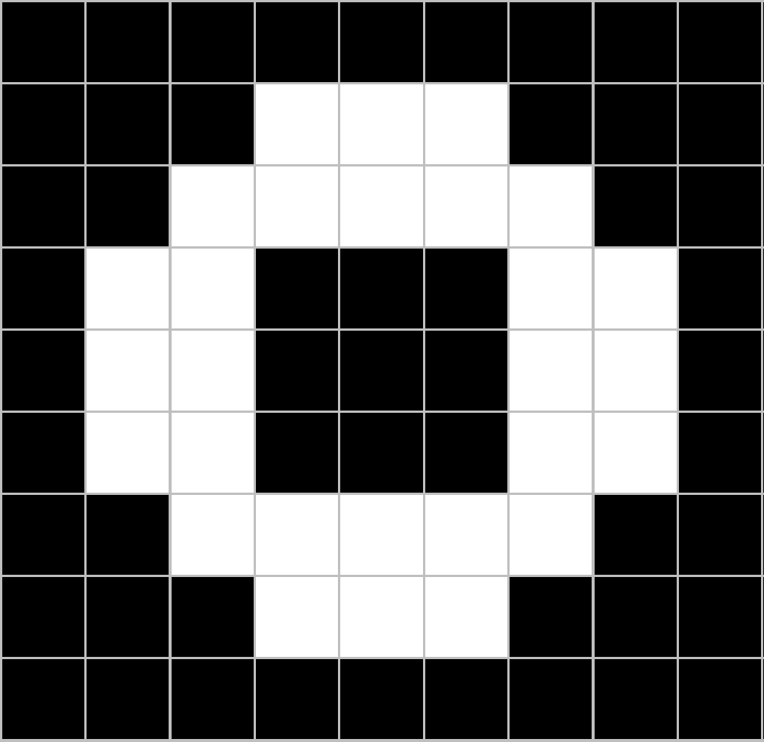
Trickier cases
CNN
X
translation
scaling
rotation
weight
CNN
O

Slide 6
Deciding is hard
?
=

Slide 7
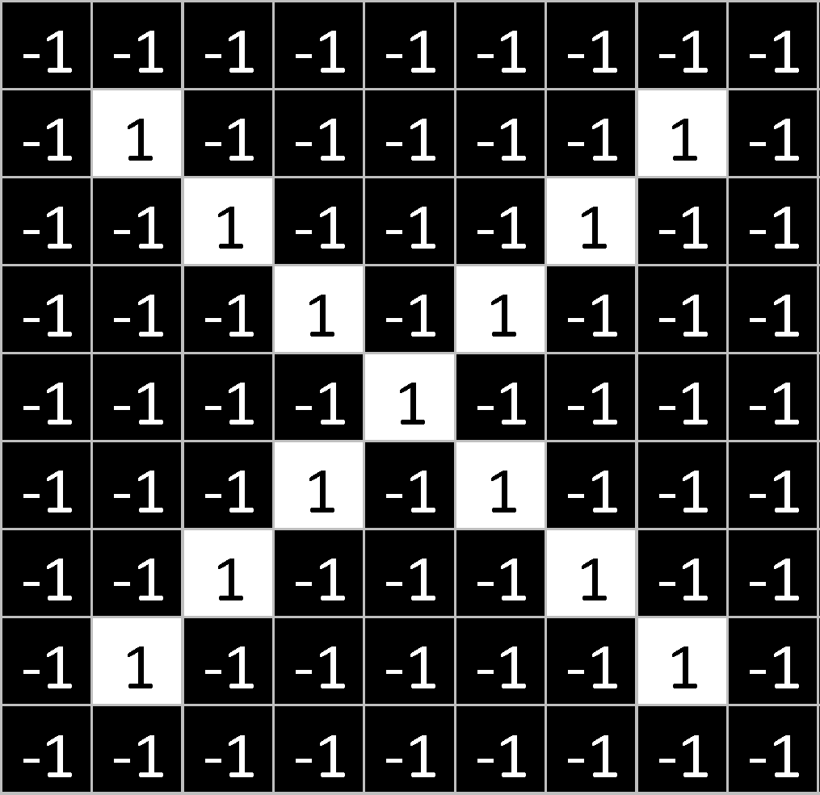
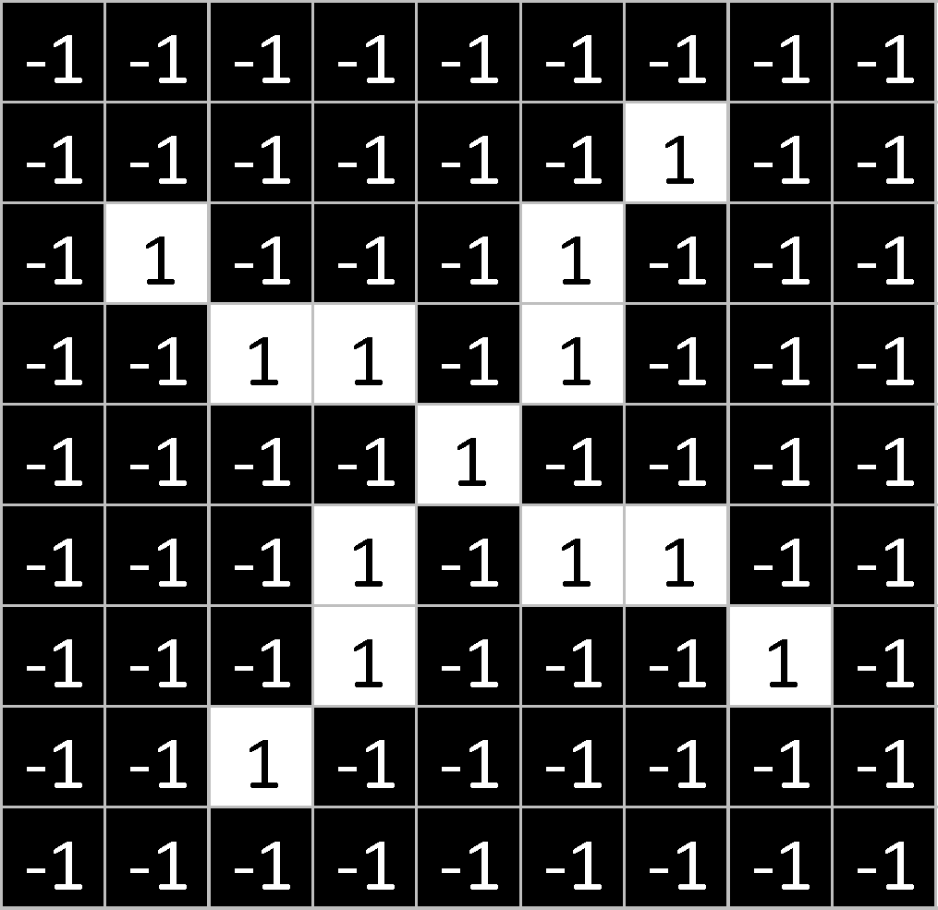
What computers see
?
=

Slide 8
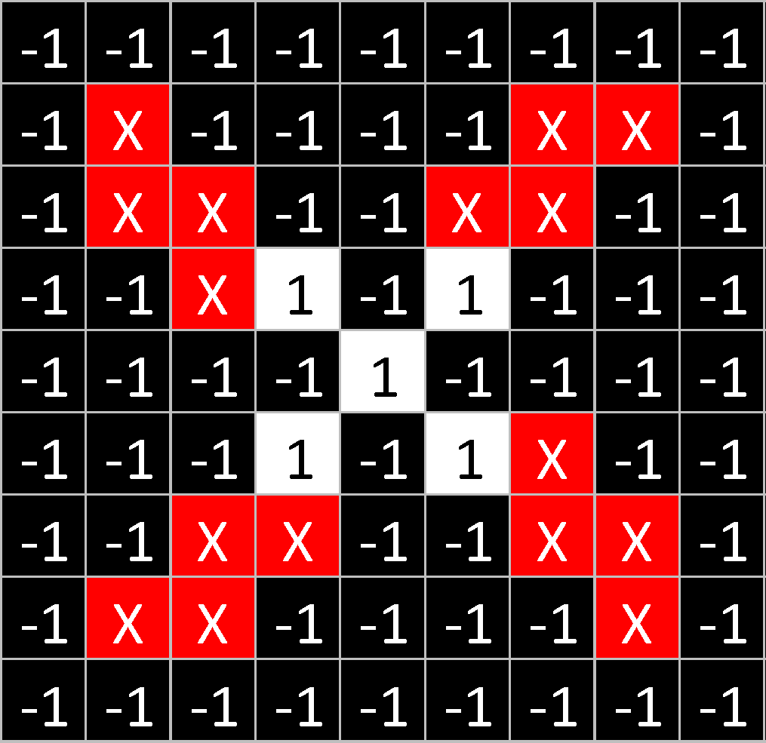
What computers see

Slide 9
Computers are literal
x
=

Slide 10
ConvNets match pieces of the image
=
=
=

Slide 11
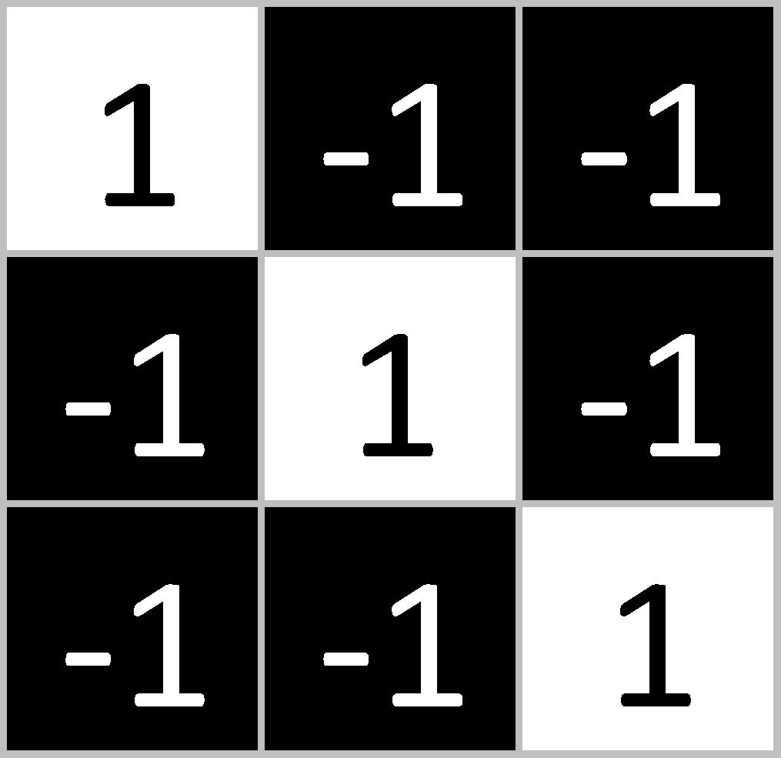
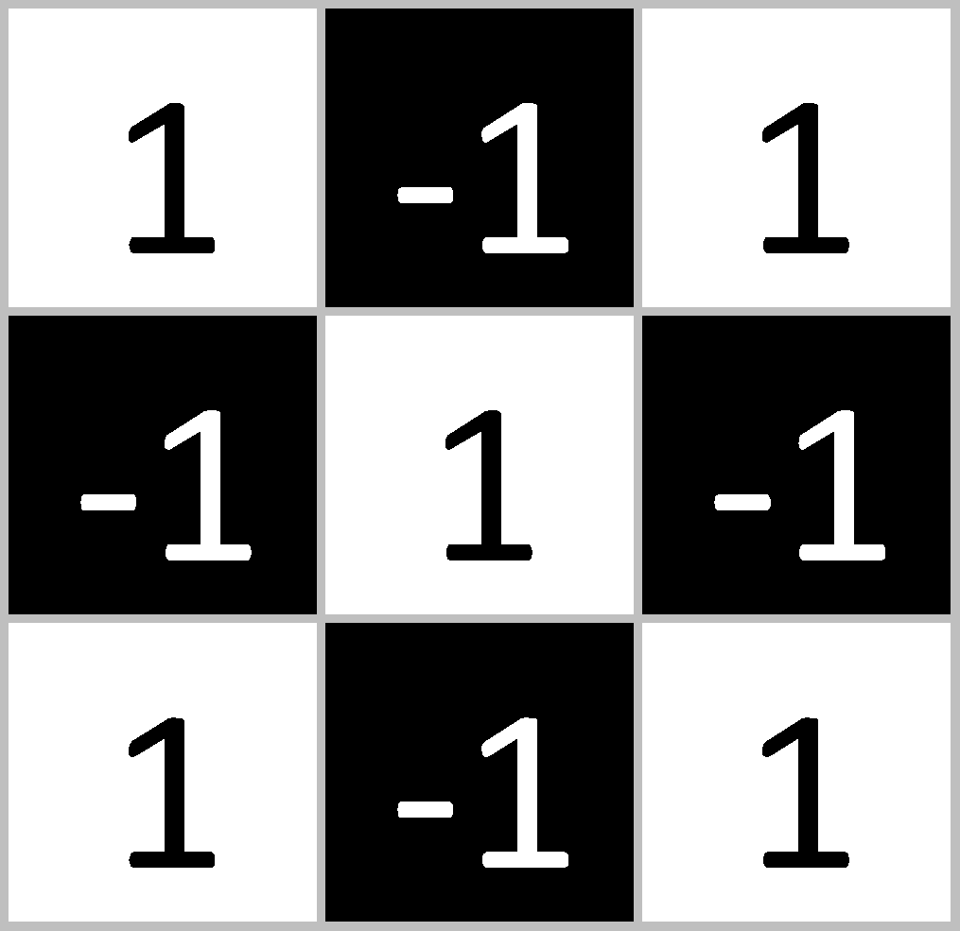
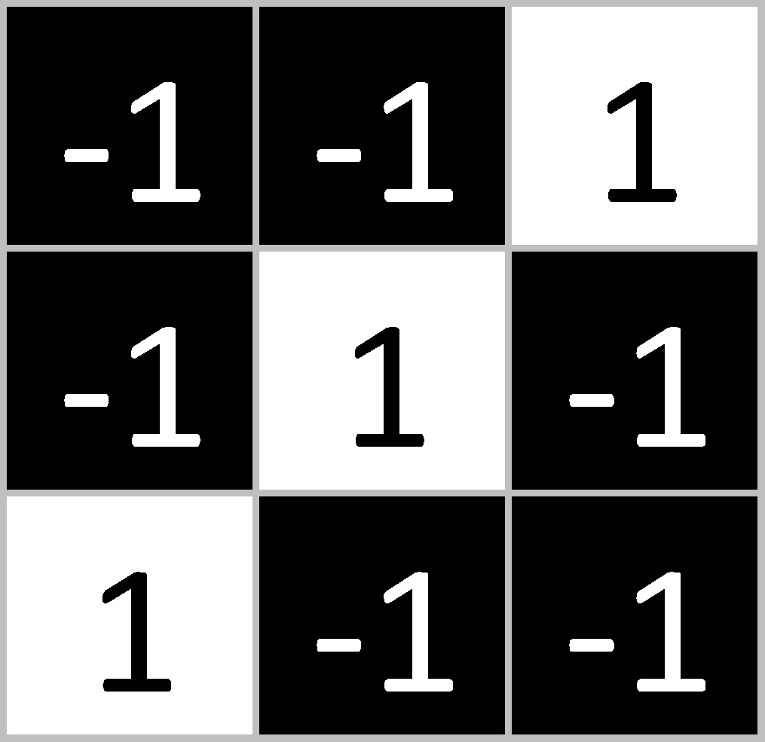
Features match pieces of the image

Slide 17
Filtering: The math behind the match

Slide 18
Filtering: The math behind the match
Line up the feature and the image patch.
Multiply each image pixel by the corresponding feature pixel.
Add them up.
Divide by the total number of pixels in the feature.

Slide 19
Filtering: The math behind the match
1 x 1 = 1

Slide 20
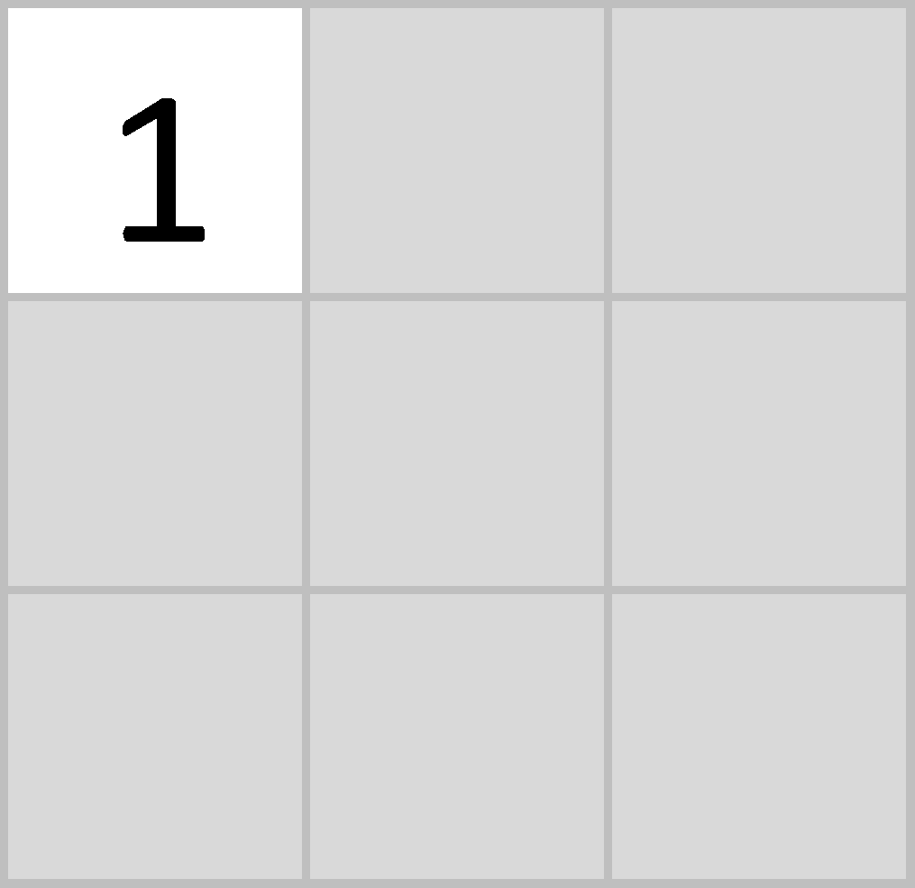
Filtering: The math behind the match
1 x 1 = 1

Slide 21
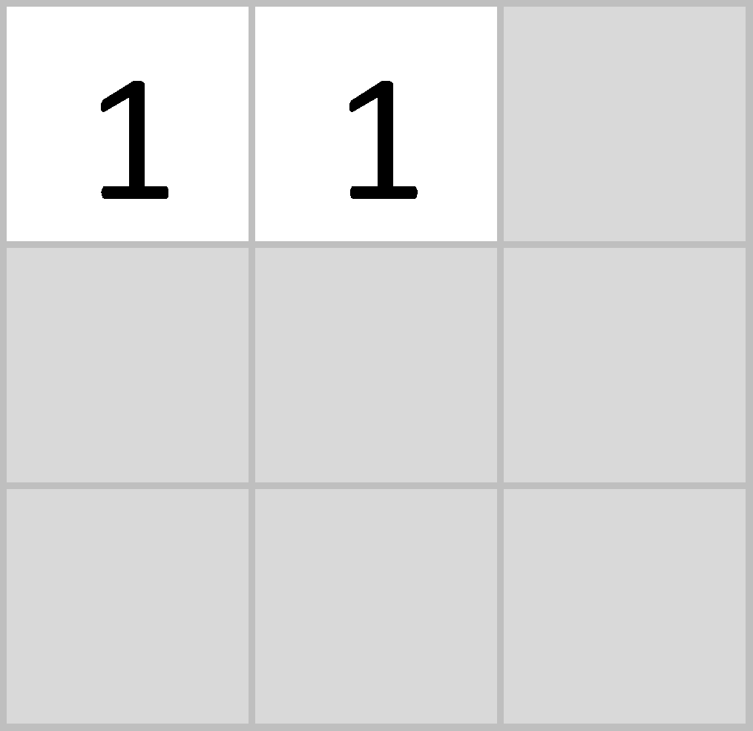
Filtering: The math behind the match
-1 x -1 = 1

Slide 22
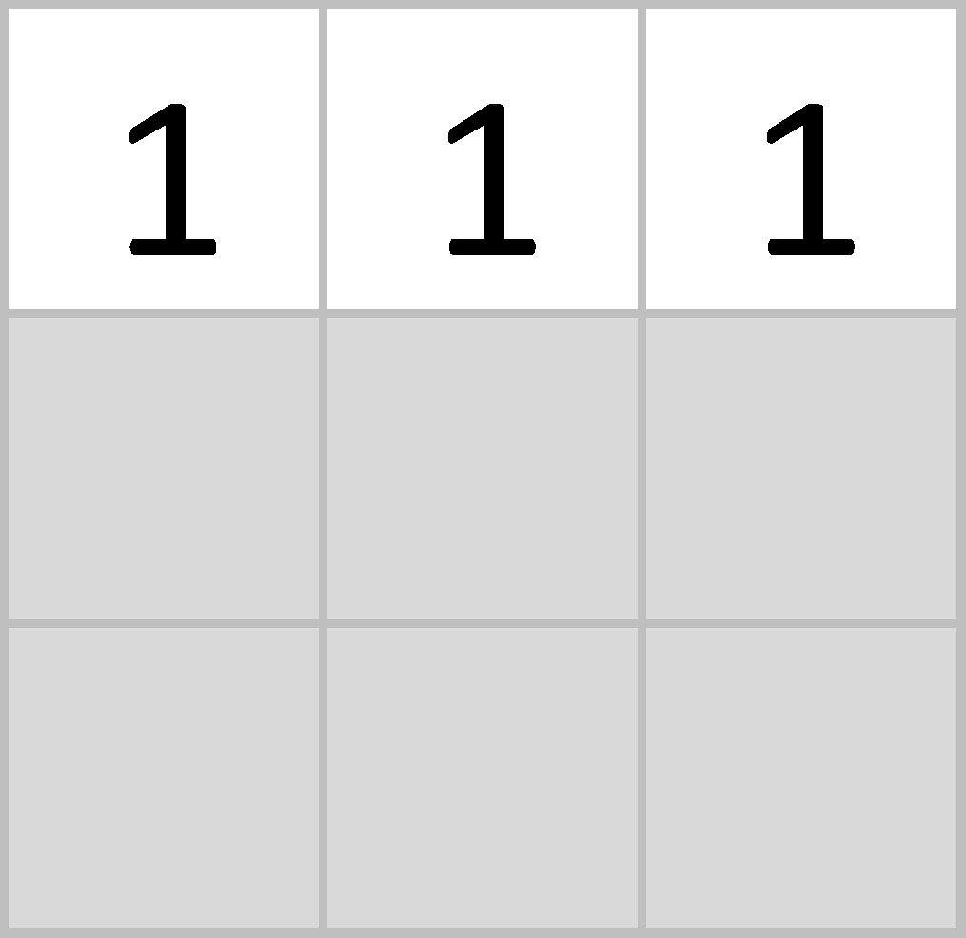
Filtering: The math behind the match
-1 x -1 = 1

Slide 23
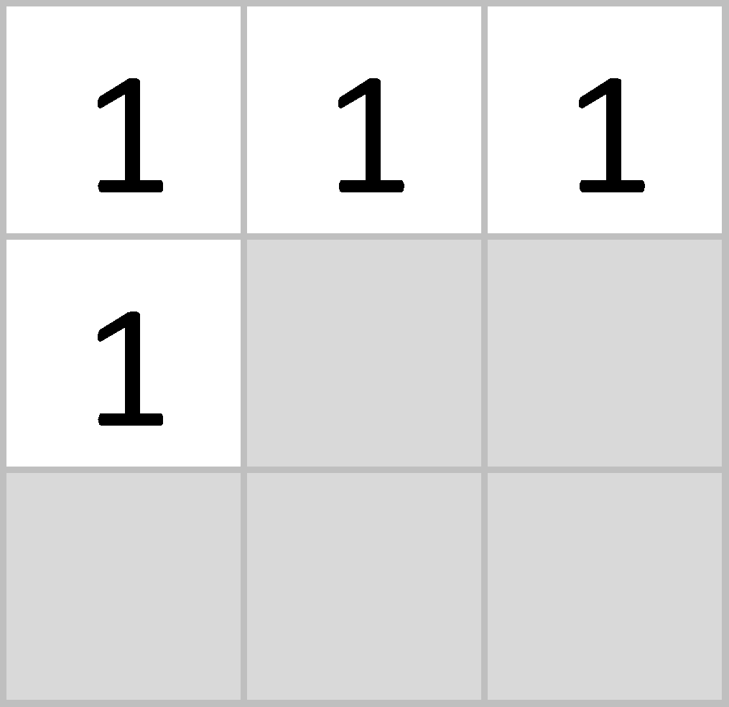
Filtering: The math behind the match
-1 x -1 = 1

Slide 24
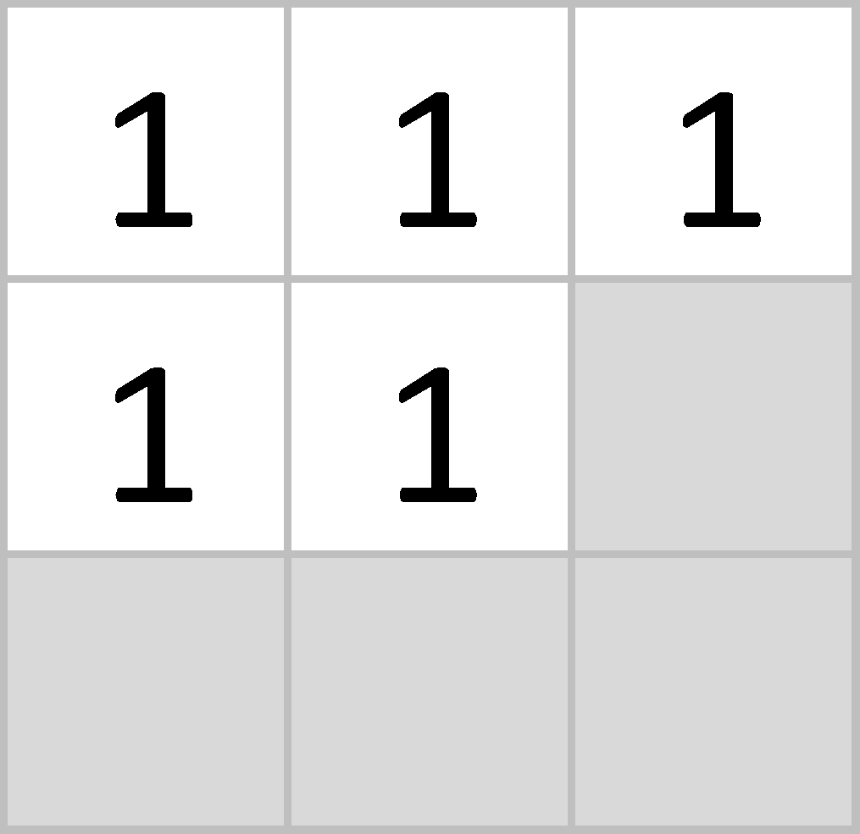
Filtering: The math behind the match
1 x 1 = 1

Slide 25
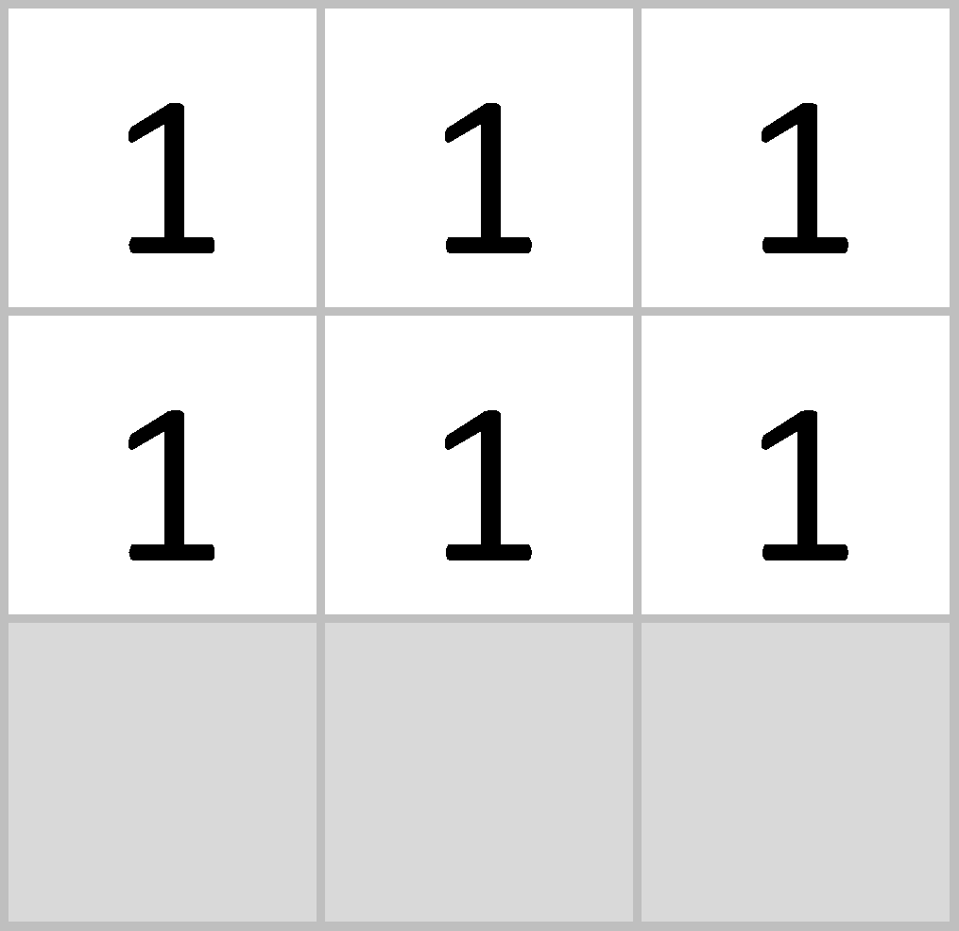
Filtering: The math behind the match
-1 x -1 = 1

Slide 26
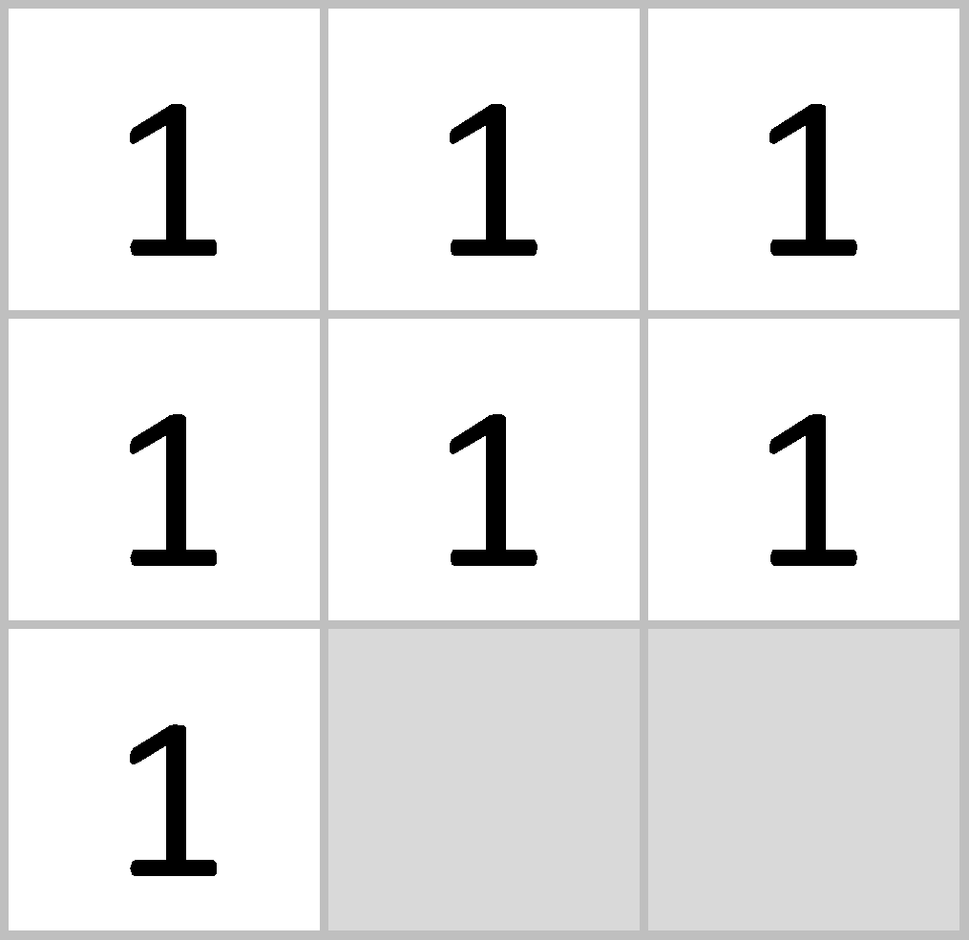
Filtering: The math behind the match
-1 x -1 = 1

Slide 27
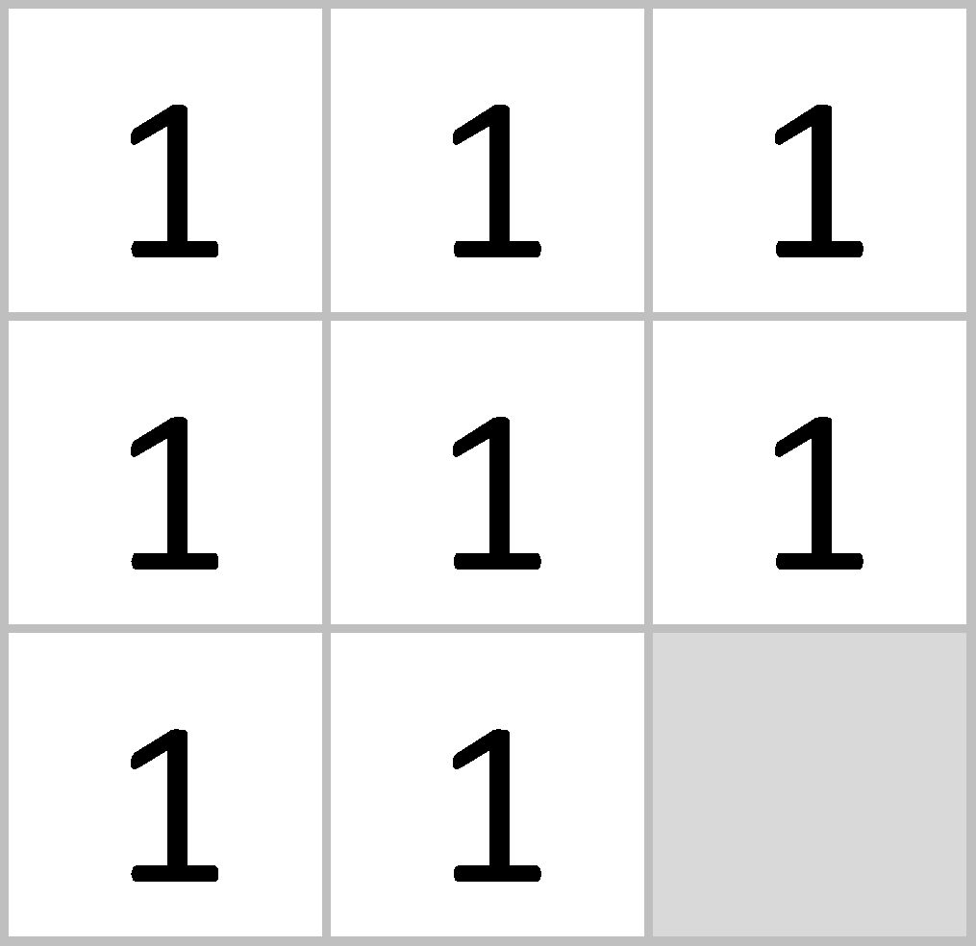
Filtering: The math behind the match
-1 x -1 = 1

Slide 28
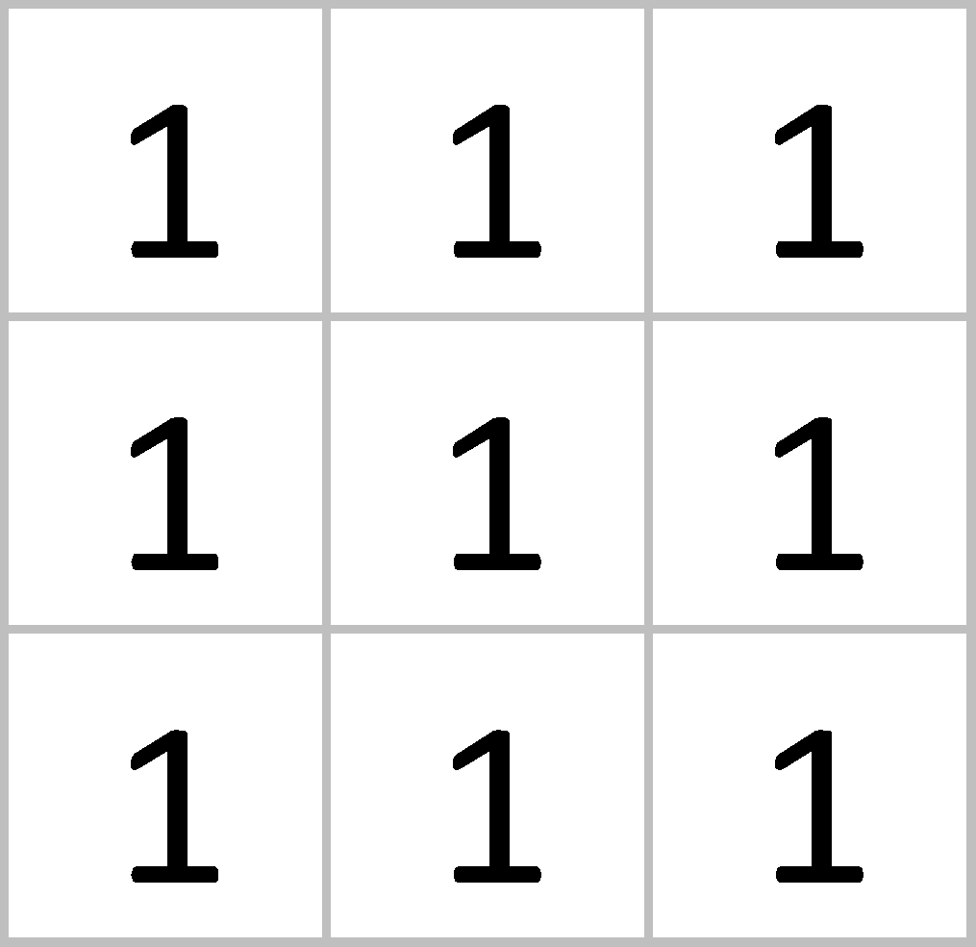
Filtering: The math behind the match
1 x 1 = 1

Slide 29
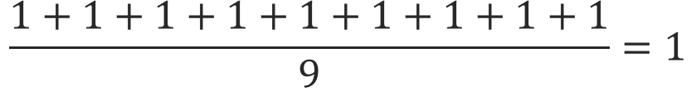
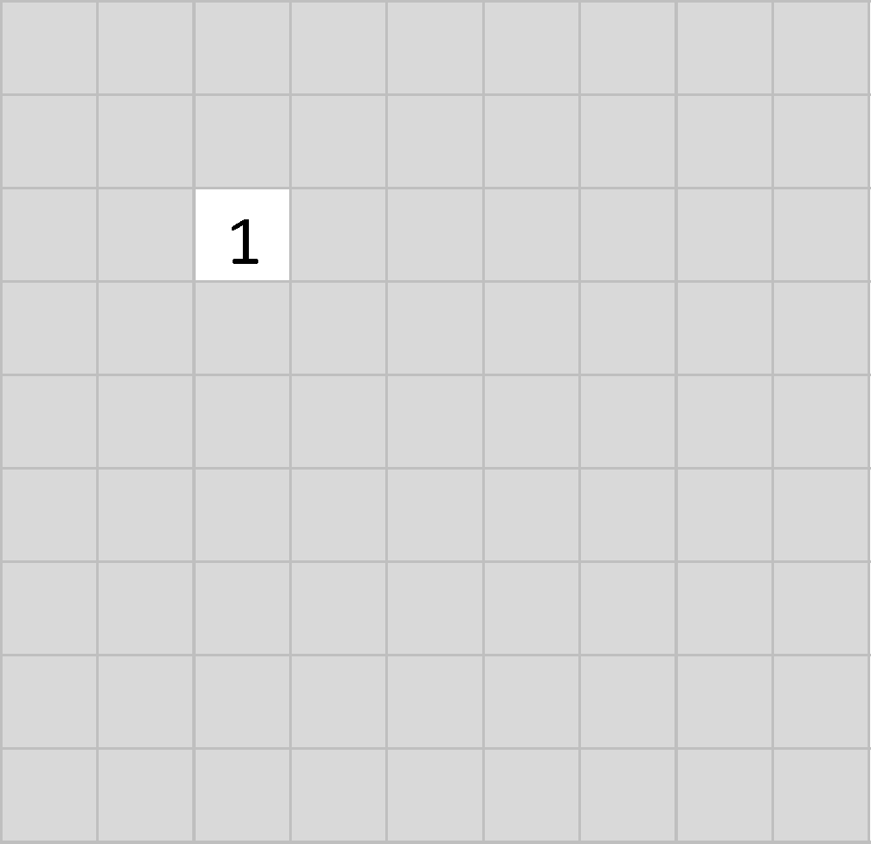
Filtering: The math behind the match

Slide 30
Filtering: The math behind the match
1 x 1 = 1

Slide 31
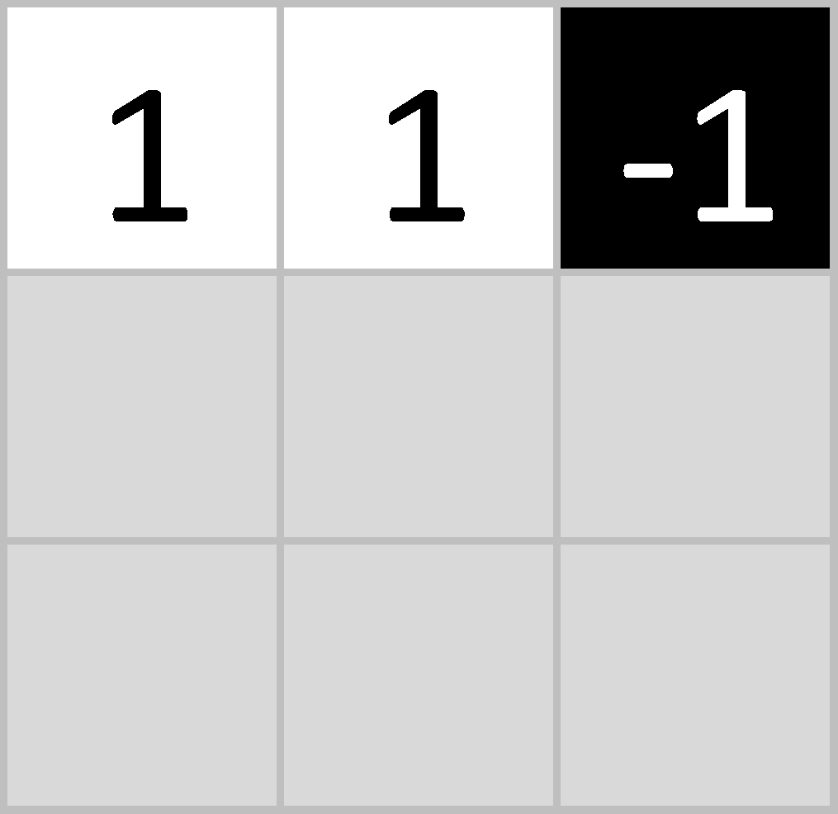
Filtering: The math behind the match
-1 x 1 = -1

Slide 32
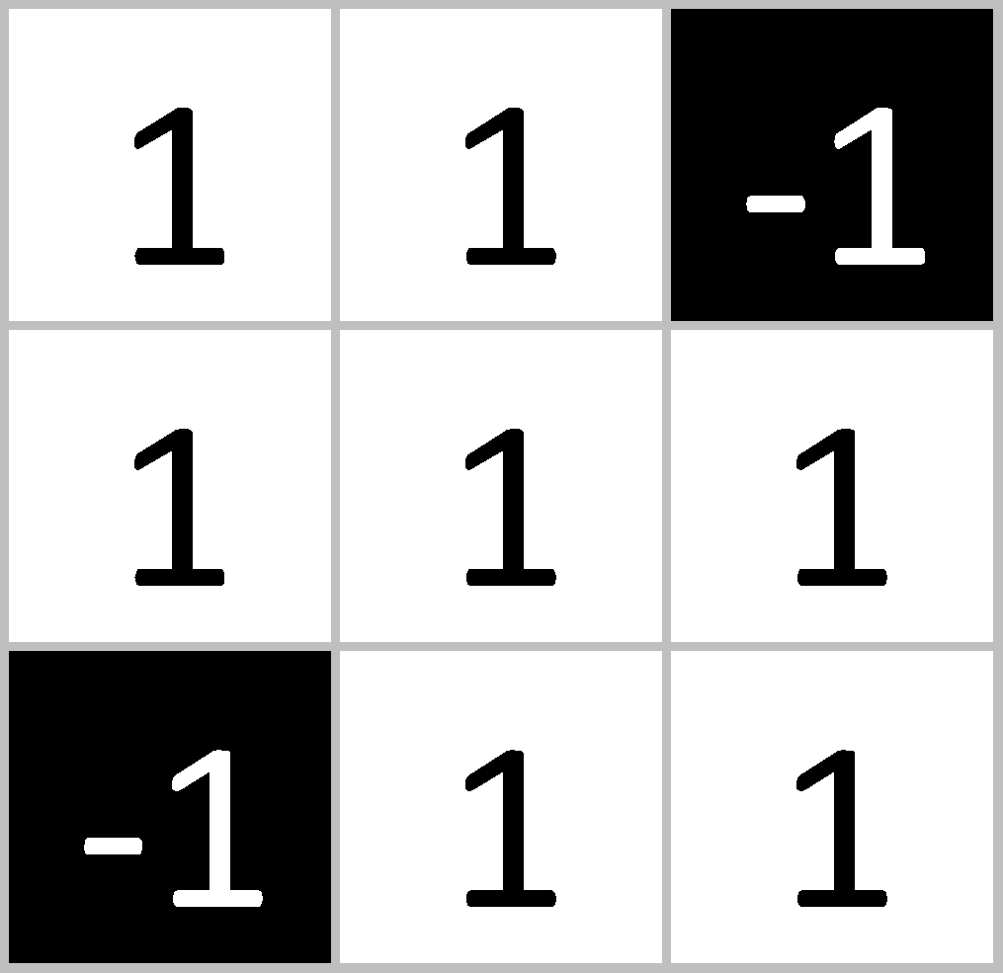
Filtering: The math behind the match

Slide 33
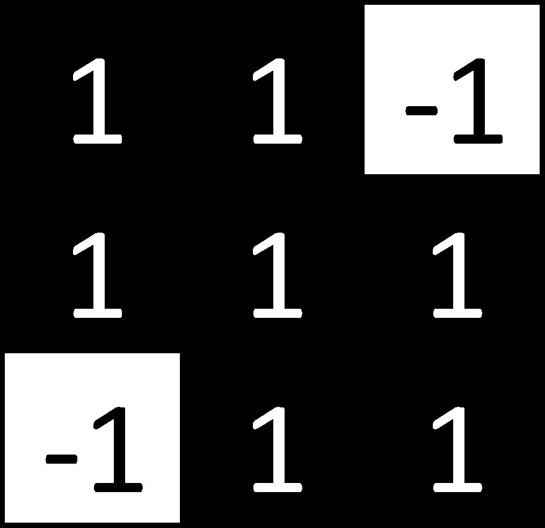
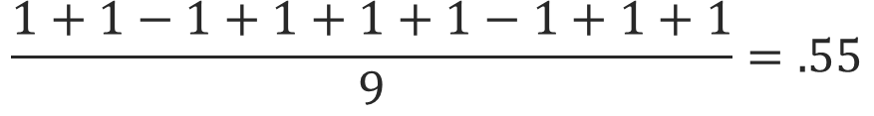
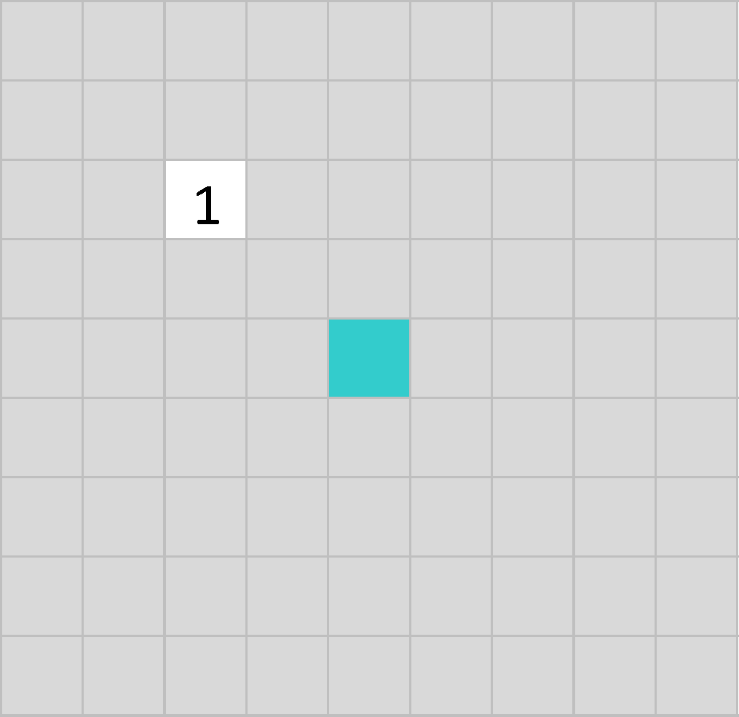
Filtering: The math behind the match
.55

Slide 34
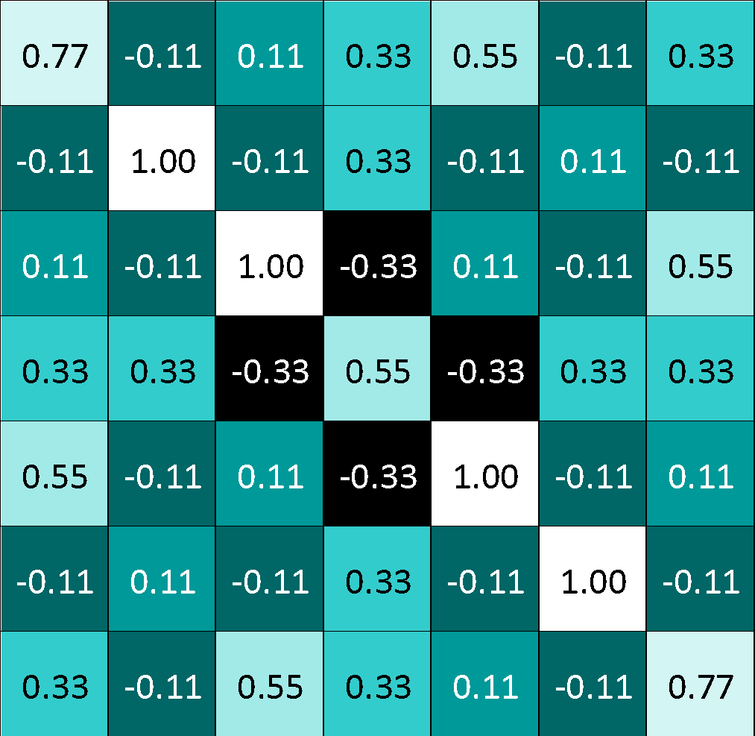
Convolution: Trying every possible match

Slide 35
Convolution: Trying every possible match
=

Slide 36
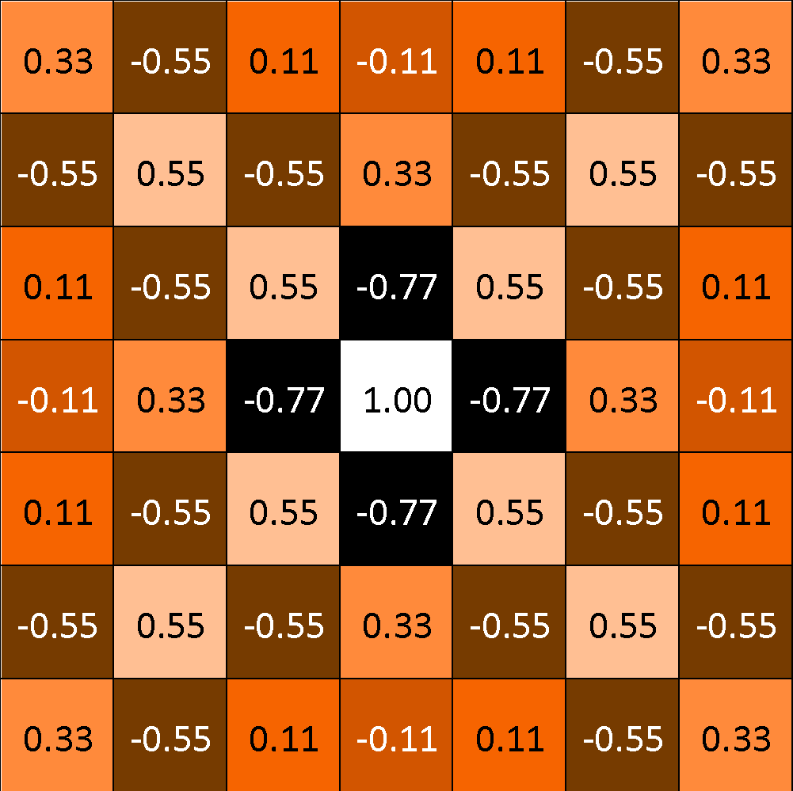
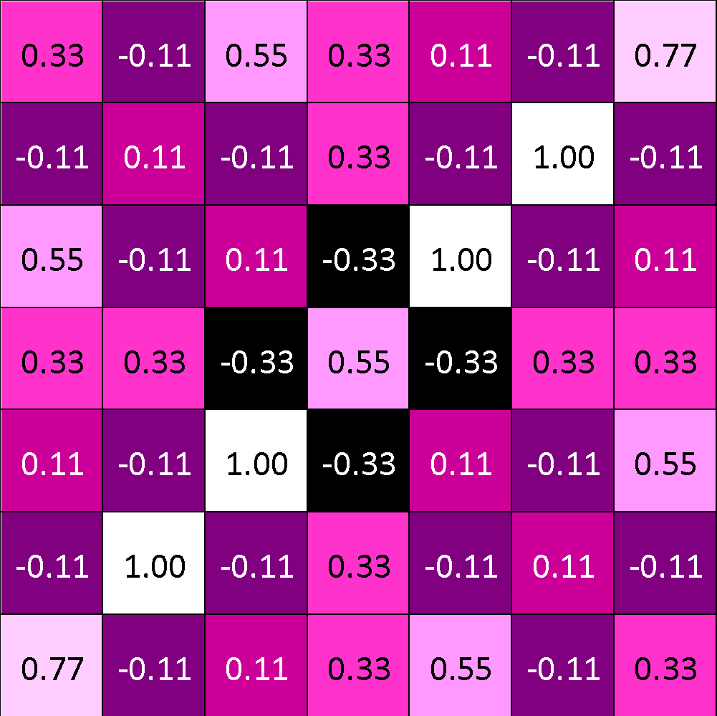
=
=
=

Slide 37
Convolution layer
One image becomes a stack of filtered images

Slide 38
Convolution layer
One image becomes a stack of filtered images

Slide 39
Pooling: Shrinking the image stack
Pick a window size (usually 2 or 3).
Pick a stride (usually 2).
Walk your window across your filtered images.
From each window, take the maximum value.

Slide 40
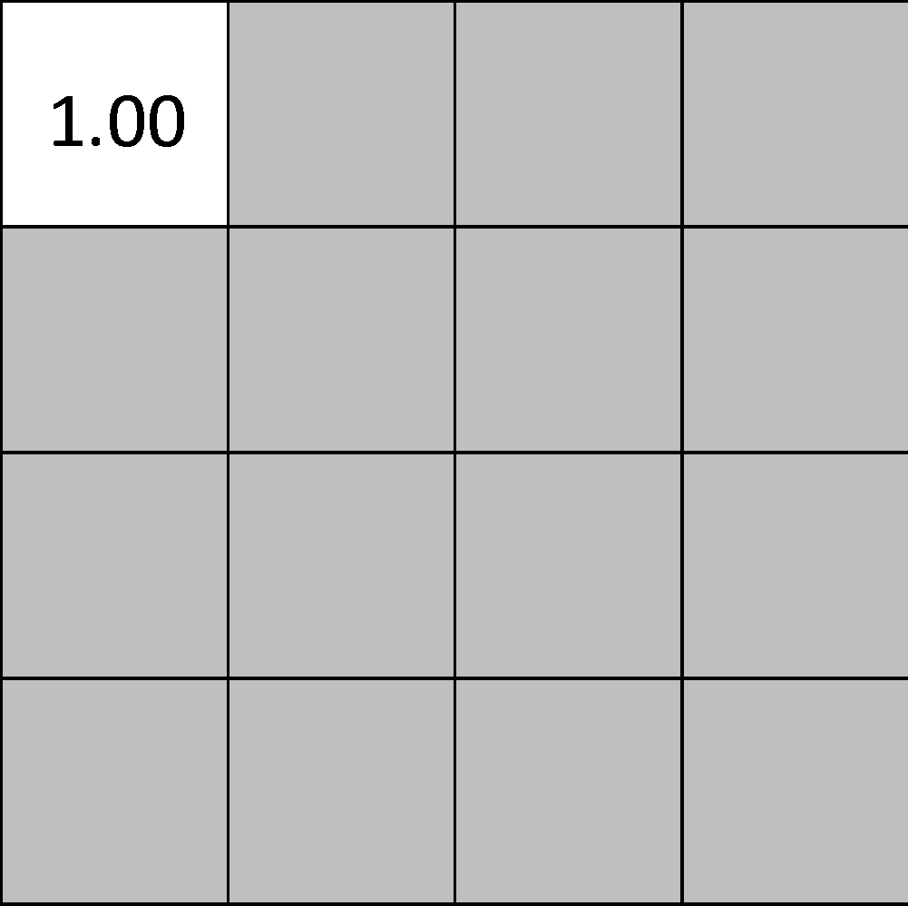
Pooling
maximum

Slide 41
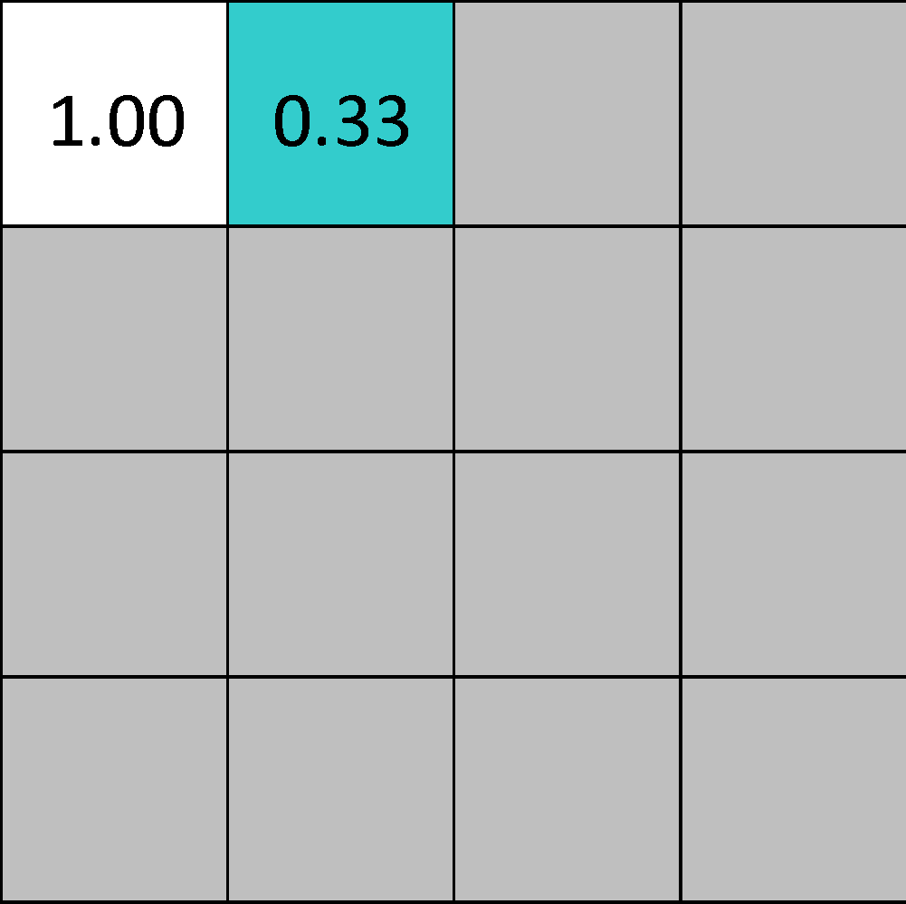
Pooling
maximum

Slide 42
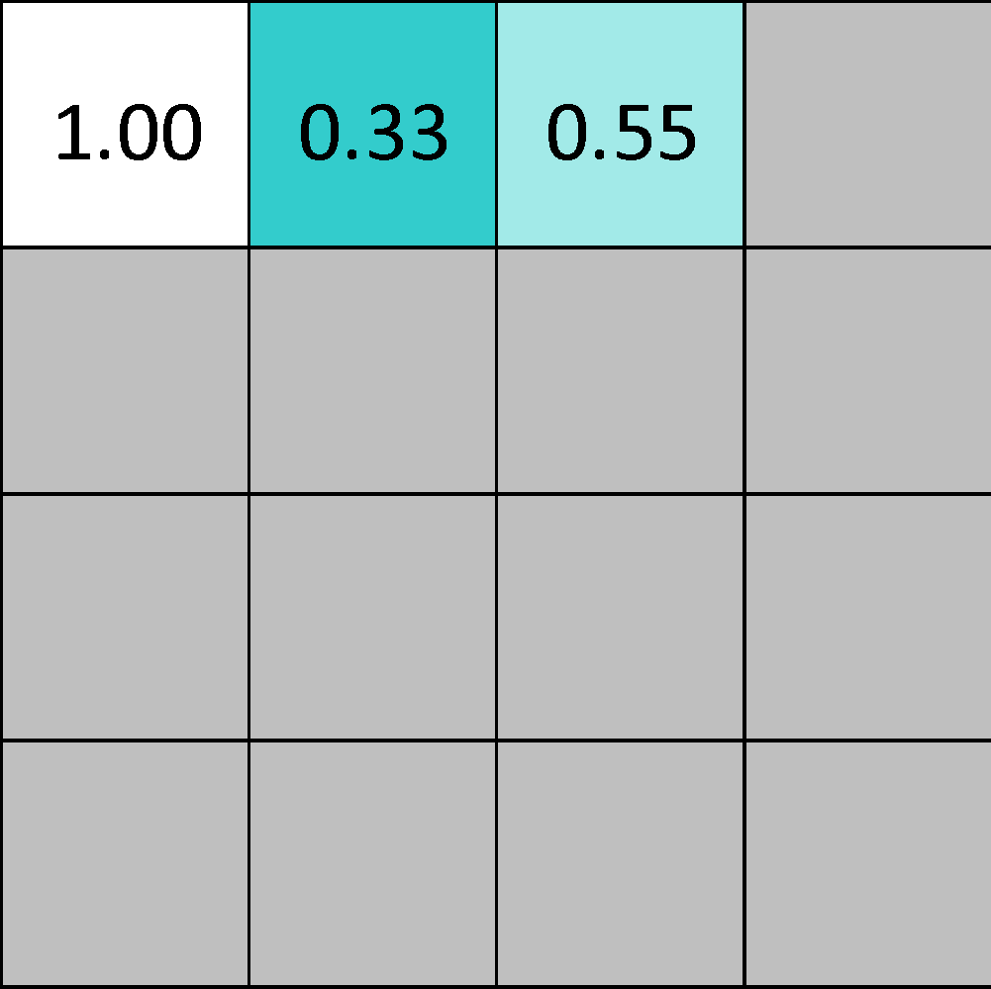
Pooling
maximum

Slide 43
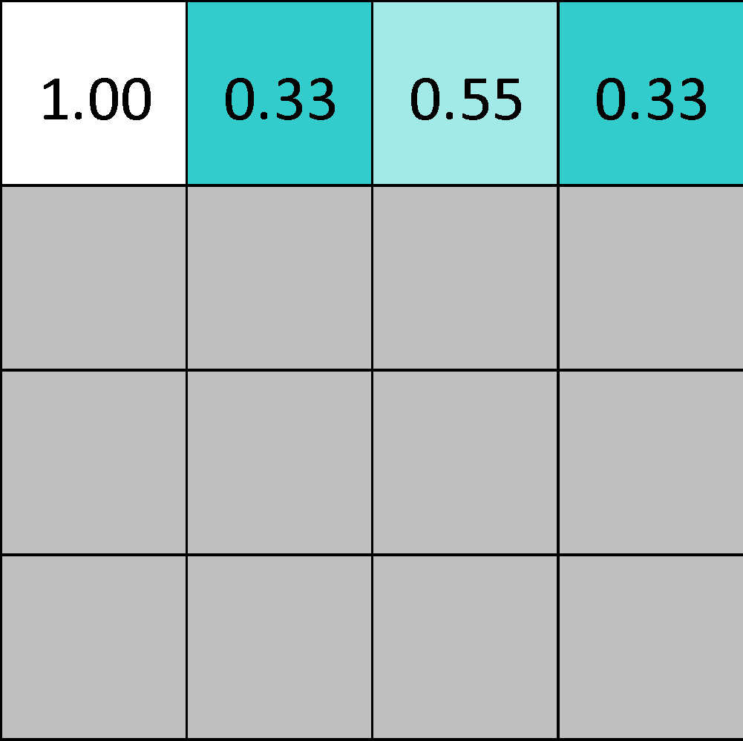
Pooling
maximum

Slide 44
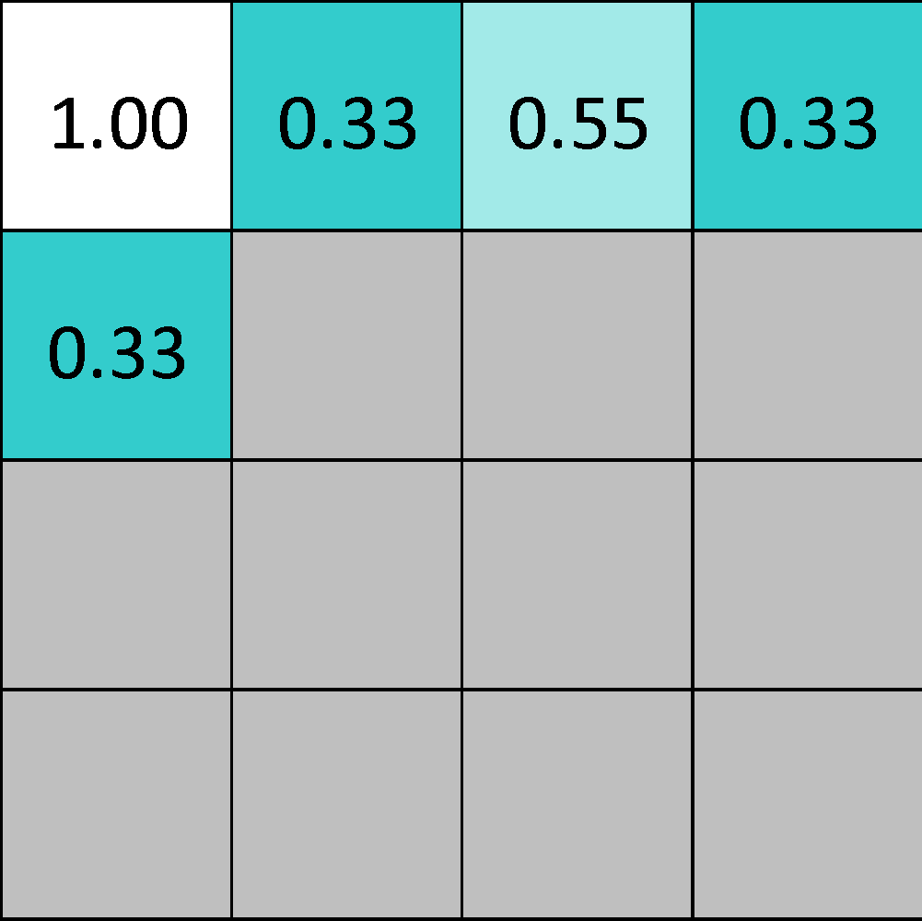
Pooling
maximum

Slide 45
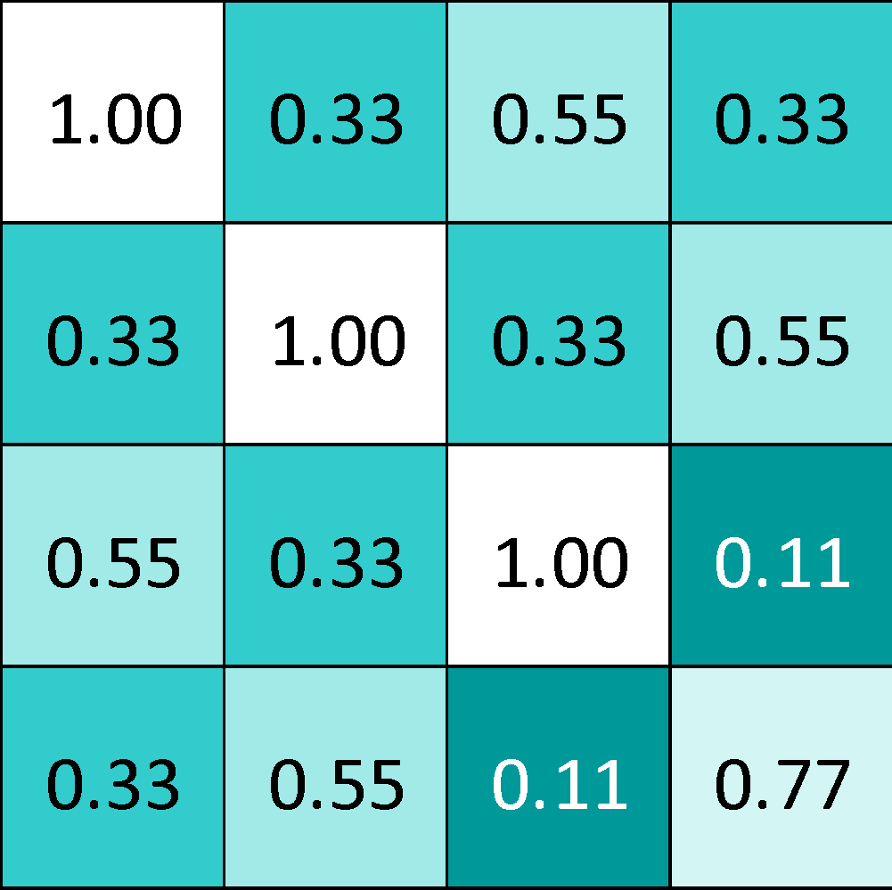
Pooling
max pooling

Slide 46
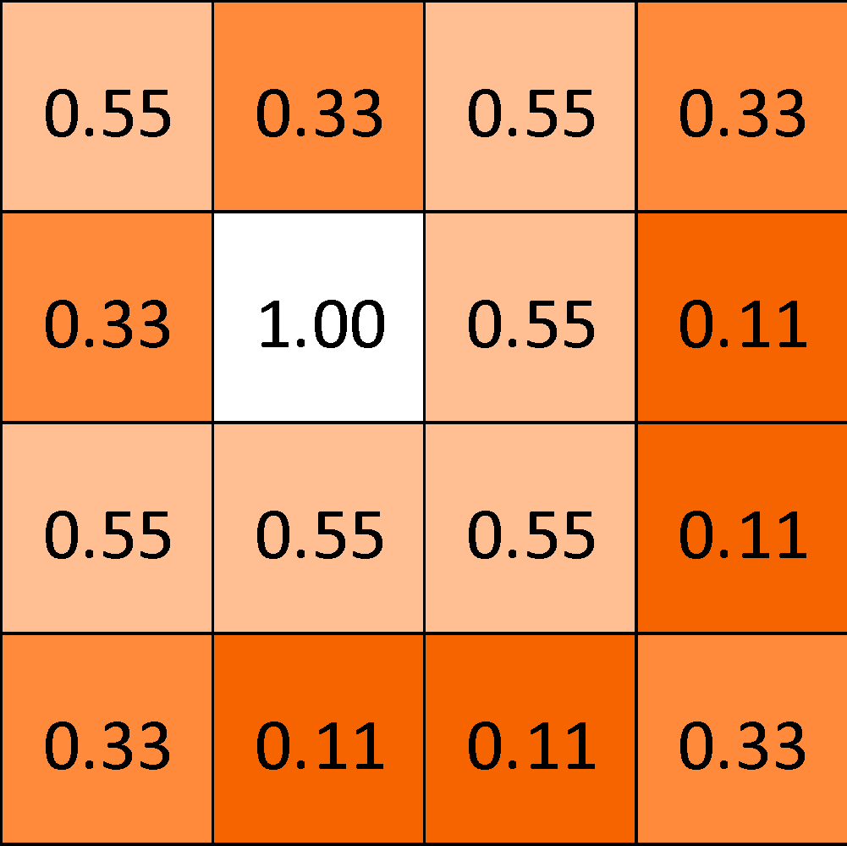
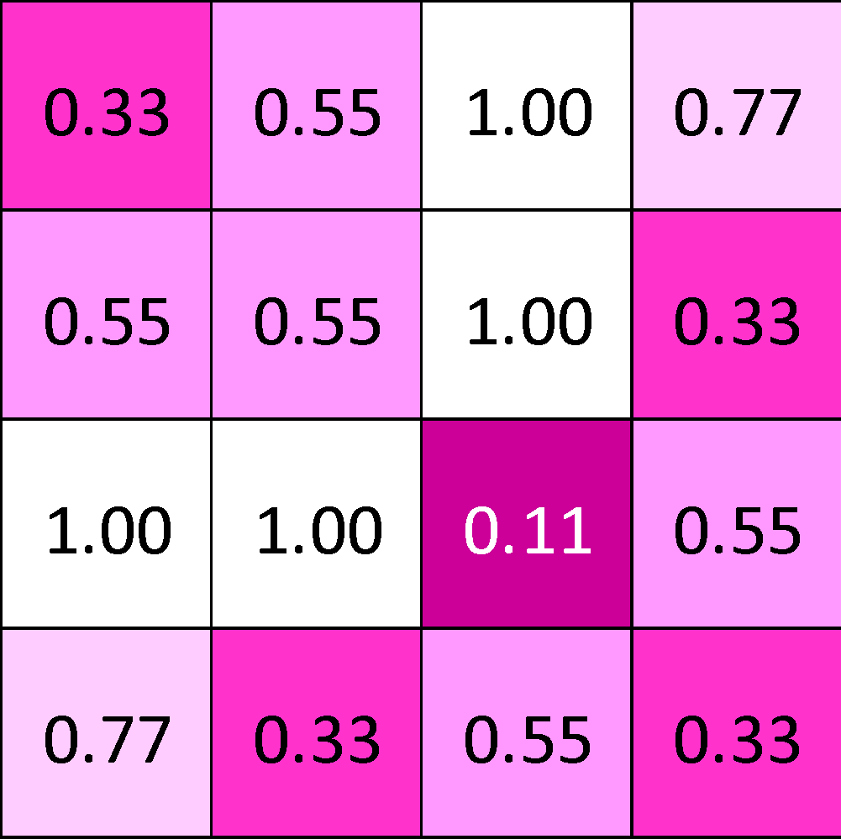

Slide 47
Pooling layer
A stack of images becomes a stack of smaller images.

Slide 48
Normalization
Keep the math from breaking by tweaking each of the values just a bit.
Change everything negative to zero.

Slide 49
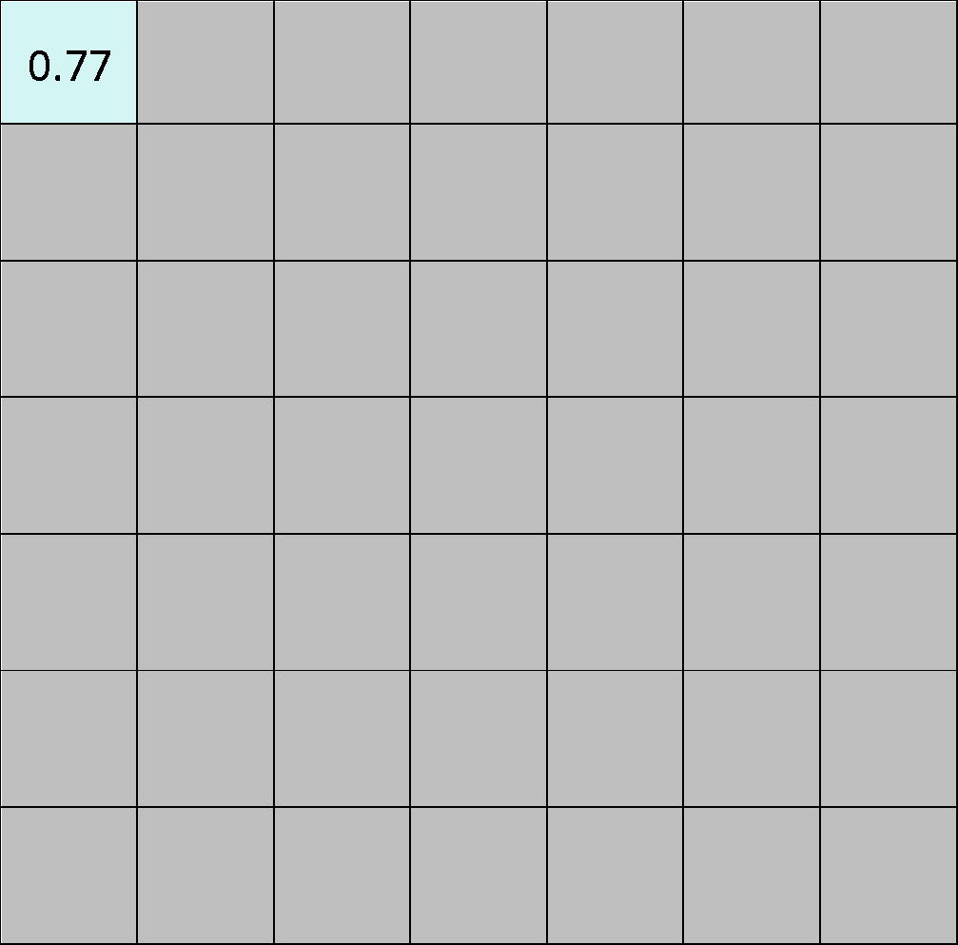
Rectified Linear Units (ReLUs)

Slide 50
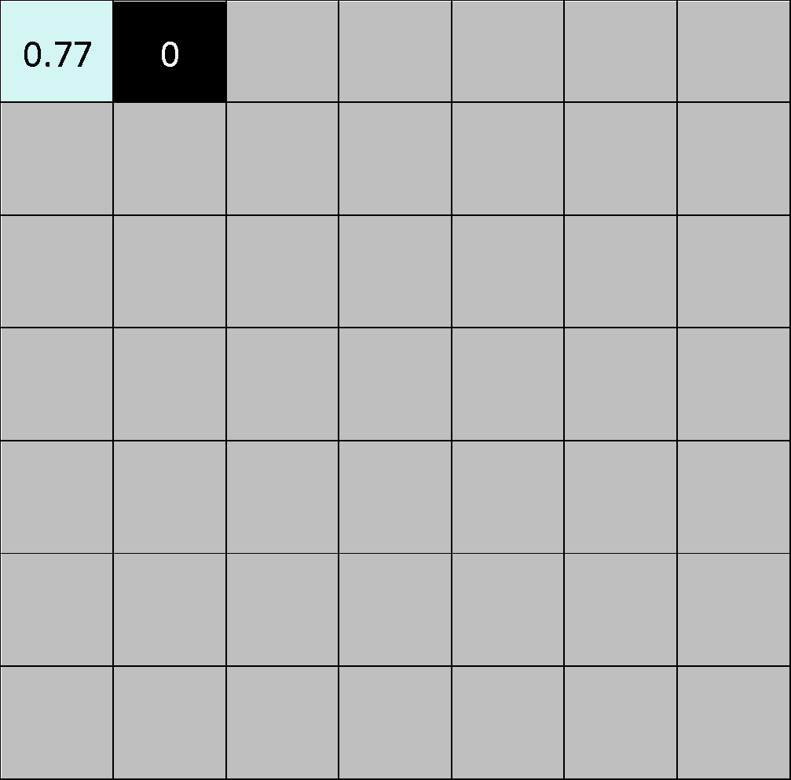
Rectified Linear Units (ReLUs)

Slide 51
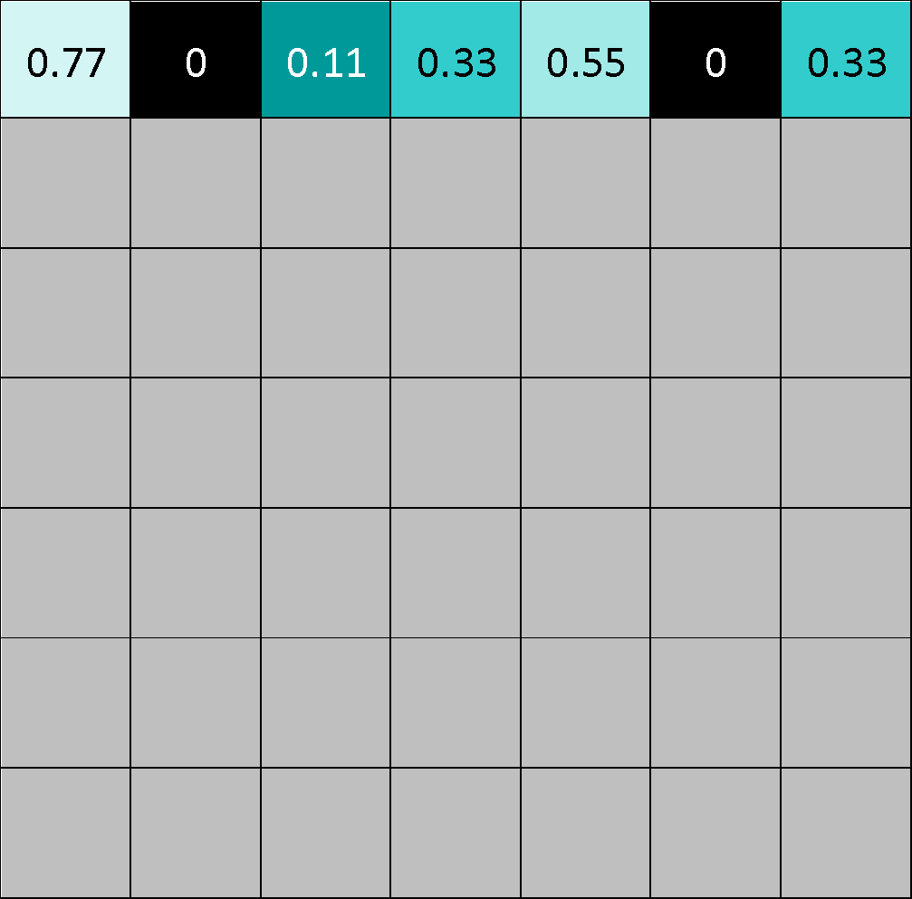
Rectified Linear Units (ReLUs)

Slide 52
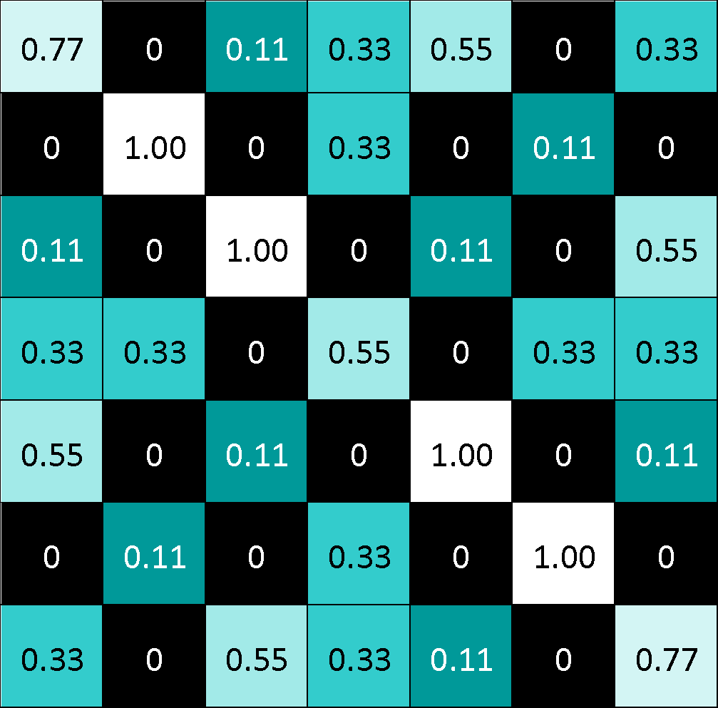
Rectified Linear Units (ReLUs)

Slide 53



ReLU layer
A stack of images becomes a stack of images with no negative values.

Slide 54
Layers get stacked
The output of one becomes the input of the next.
Convolution
ReLU
Pooling

Slide 55



Deep stacking
Layers can be repeated several (or many) times.
Convolution
ReLU
Convolution
ReLU
Pooling
Convolution
ReLU
Pooling

Slide 56
Fully connected layer
Every value gets a vote

Slide 57
Fully connected layer
Vote depends on how strongly a value predicts X or O
X
O

Slide 58
Fully connected layer
Vote depends on how strongly a value predicts X or O
X
O

Slide 59
Fully connected layer
Future values vote on X or O
X
O

Slide 60
Fully connected layer
Future values vote on X or O
X
O

Slide 61
Fully connected layer
Future values vote on X or O
X
.92
O

Slide 62
Fully connected layer
Future values vote on X or O
X
.92
O

Slide 63
Fully connected layer
Future values vote on X or O
X
.92
O
.51

Slide 64
Fully connected layer
Future values vote on X or O
X
.92
O
.51

Slide 65
Fully connected layer
A list of feature values becomes a list of votes.
X
O

Slide 66
Fully connected layer
These can also be stacked.
X
O

Slide 67
Putting it all together
A set of pixels becomes a set of votes.
.92
X
Convolution
ReLU
Fully
connected
Fully
connected
Convolution
ReLU
Convolution
ReLU
Pooling
Pooling
O
.51

Slide 68
Learning
Q: Where do all the magic numbers come from?
Features in convolutional layers
Voting weights in fully connected layers
A: Backpropagation

Slide 69
Backprop
Error = right answer – actual answer
.92
X
Convolution
ReLU
Fully
connected
Fully
connected
Convolution
ReLU
Convolution
ReLU
Pooling
Pooling
O
.51

Slide 70

Backprop
.92
X
Convolution
ReLU
Fully
connected
Fully
connected
Convolution
ReLU
Convolution
ReLU
Pooling
Pooling
O
.51

Slide 71

Backprop
.92
X
Convolution
ReLU
Fully
connected
Fully
connected
Convolution
ReLU
Convolution
ReLU
Pooling
Pooling
O
.51

Slide 72

Backprop
.92
X
Convolution
ReLU
Fully
connected
Fully
connected
Convolution
ReLU
Convolution
ReLU
Pooling
Pooling
O
.51

Slide 73

Backprop
.92
X
Convolution
ReLU
Fully
connected
Fully
connected
Convolution
ReLU
Convolution
ReLU
Pooling
Pooling
O
.51

Slide 74

Backprop
.92
X
Convolution
ReLU
Fully
connected
Fully
connected
Convolution
ReLU
Convolution
ReLU
Pooling
Pooling
O
.51

Slide 75
Hyperparameters (knobs)
Convolution
Number of features
Size of features
Pooling
Window size
Window stride
Fully Connected
Number of neurons

Slide 76
Not just images
Any 2D (or 3D) data.
Things closer together are more closely related than things far away.

Slide 77
Images
Columns of pixels
Rows of pixels

Slide 78

Sound
Time steps
Intensity in each
frequency band

Slide 79

Text
Position in
sentence
Words in
dictionary

Slide 80
Limitations
ConvNets only capture local “spatial” patterns in data.
If the data can’t be made to look like an image, ConvNets are less useful.

Slide 81

Customer data
Name, age,
address, email,
purchases,
browsing activity,…
Customers

Slide 82
Rule of thumb
If your data is just as useful after swapping any of your columns with each other, then you can’t use Convolutional Neural Networks.

Slide 83
In a nutshell
ConvNets are great at finding patterns and using them to classify images.

Slide 84
How to debug neural networks
Plot most wrong prediction

Slide 85


Slide 86
How to debug neural networks
Plot most wrong prediction
Plot confusion matrix

Slide 87


Slide 88
How to debug neural networks
Plot most wrong prediction
Plot confusion matrix
Clean data

Slide 89
How to debug neural networks
Plot most wrong prediction
Plot confusion matrix
Clean data
Look at the matrices

Slide 90


Look, they are easy to understand! (actually no)

Slide 91


Slide 92

Find woman in red dress

Slide 93
What would be better?
We are working with images, can we get some images which will explain CNN?

Slide 94
Visualize CNN
Activation Maximization

Slide 95
Find best image
.92
X
Convolution
ReLU
Fully
connected
Fully
connected
Convolution
ReLU
Convolution
ReLU
Pooling
Pooling
O
.51

Slide 96

How?
Target optimization function
- - image we want to find
- convolution filter weight we want to visualize
Repeat for every convolution filter

Slide 97
Convolutional Deep Belief Networks for Scalable Unsupervised Learning of Hierarchical Representations (Honglak Lee, Roger Grosse, Rajesh Ranganath, Andrew Y. Ng)

Slide 98


What will CNN learn in real images?

Slide 99

What will CNN learn in real images?

Slide 100

What will CNN learn in real images?

Slide 101
Find best wrong image
.92
X
Convolution
ReLU
Fully
connected
Fully
connected
Convolution
ReLU
Convolution
ReLU
Pooling
Pooling
O
.51

Slide 102

Adversarial attacks

Slide 103
Architecture
How many of each type of layer?
In what order?
Anything else???

Slide 104

Autoencoder

Slide 105

Autoencoder for image denoising

Slide 106


Autoencoder for anomaly detection
Good image loss:
5.43209
Bad image loss:
6789.4907

Slide 107

Autoencoder arithmetic

Slide 108

Autoencoder arithmetic

Slide 109

Autoencoder arithmetic

Slide 110

Autoencoder arithmetic

Slide 111

Autoencoder U-net for segmentation

Slide 112
Thank you!

